Slide 1
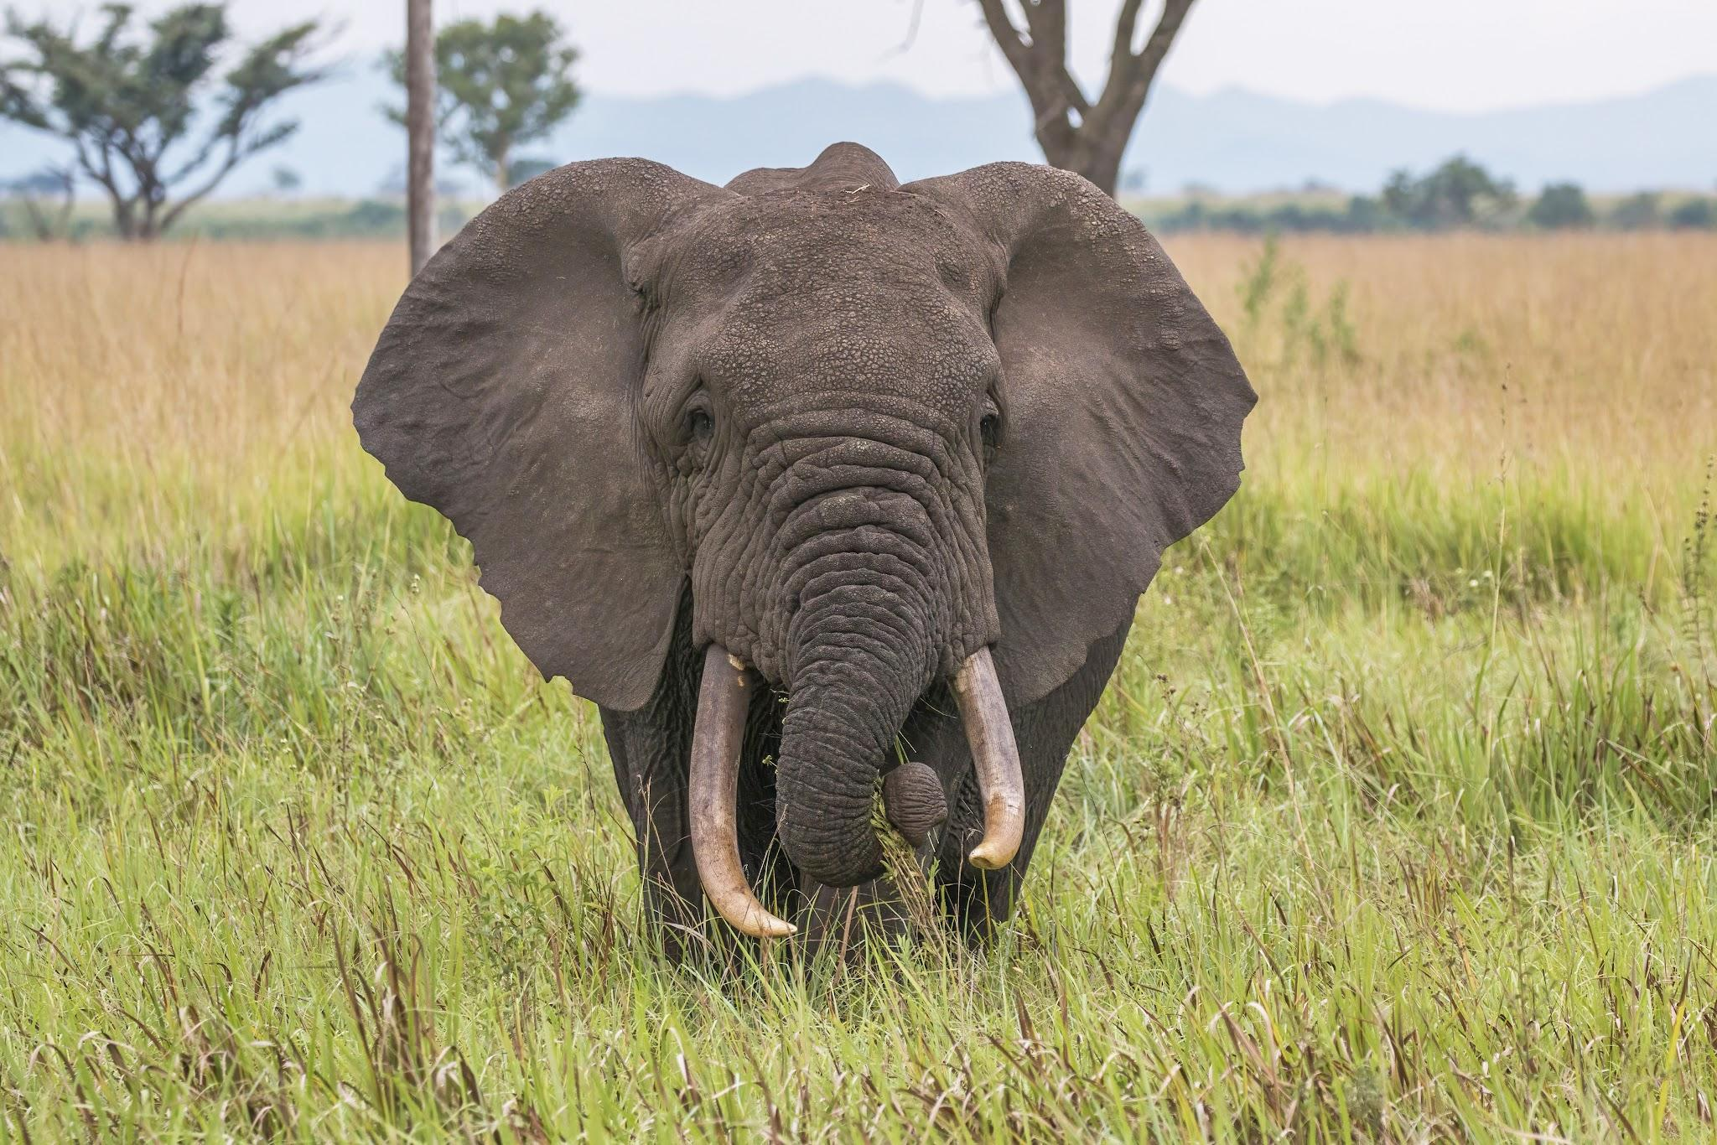
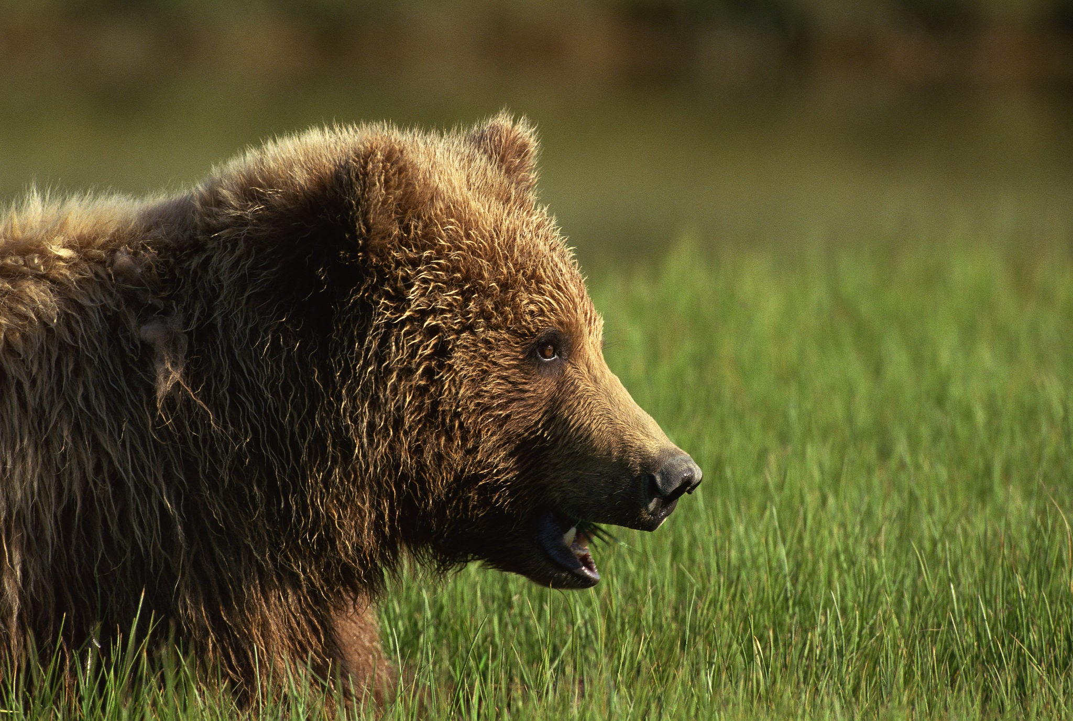

Giants and Guardians: A Global Conservation Comparison 🌍
Comparing Challenges & Solutions in Africa, the Us and Canada

Slide 2
Challenges We Will Compare:
1. Habitat Fragmentation
2. Human-Wildlife Conflict (HWC)
3. Illegal Exploitation (Trade/Poaching)
Notes:
"We're comparing three large species—Elephants, Caribou, and Grizzlies—to see how they face the same three global problems."

Slide 3
Challenge 1: Habitat Fragmentation
Challenge 1: Sliced Habitats (Fragmentation)
Definition: "When human development (roads, towns, logging) cuts natural landscapes into isolated pieces."
North American Example🇺🇸🇨🇦
The Problem: Highways and logging break up migration routes for Grizzlies and Caribou. Small populations get isolated and can't find new mates or enough resources.
Africa Example🇿🇦🇰🇪
The Problem: Settlements and farms cut Elephant Corridors, preventing herds from reaching vital seasonal food and water sources.
Connect the Dots: "The problem is the same: the animals can't move.”
Global Solution Connectivity & Wildlife Crossings
(The need to link habitats).
Resource Link for Students: Yellowstone to Yukon Conservation Initiative (Y2Y)

Slide 4
Solution Spotlight: Wildlife Crossings
North America- Massive Overpasses (bridges) and Underpasses (tunnels) are built over and under highways (e.g., Banff National Park, Utah).Video Link: WATCH: Incredible Wildlife Overpass (Video)
Africa/Asia- Similar Underpasses or dedicated tunnels are built beneath roads or railways, specifically designed for large, wide animals like elephants.
Contrast: "The engineering is the same—we're creating safe passage across human infrastructure.
"Key Takeaway: This is a Universal Engineering Solution to Fragmentation.

Slide 5
Challenge 2: Human-Wildlife Conflict (HWC)
Challenge 2: Learning to Coexist (HWC)
Definition: "Conflict happens when our needs directly clash with an animal's needs (food, space, safety)."
North America HWC- Grizzlies: Attracted to human garbage, fruit trees, and unsecured food. Conflicts lead to the animal being euthanized or relocated.Resource Link for Students: Getting along with grizzly bears (Knowable Magazine)
Africa HWC- Elephants: Raid highly valuable crops (corn, wheat), leading farmers to use lethal force to protect their livelihoods.
Focus: "This is a survival issue for both the farmer and the elephant.
"Principle ExchangeDiscussion Point: Africa uses non-lethal deterrents like beehive fences to scare elephants away. What creative, non-lethal solutions can North America adapt for its bears or coyotes?
Activity Resource: How to Outsmart an Elephant (WWF Activity)

Slide 6
Challenge 3: Illegal Exploitation
Challenge 3: The Threat of the Trade (Poaching & Trafficking)
Definition: The illegal movement of animal parts for profit.
Africa Focus- Poaching: Elephants are targeted primarily for their ivory. This trade is a major driver of population collapse.
Speaker Note: "This is a global crime worth billions, often tied to organized crime networks."U.S. / Canada Role- Consumer Market: North America is a major destination for illegal wildlife products (exotic pets, illegal timber, animal parts). We are part of the demand chain.
Action: Discuss Canada's new restrictions on elephant ivory trade.
Civic Action - Resource for Students: Illegal Wildlife Trade: Investigations (WWF-UK)

Slide 7
Conclusion and Next Steps
Conclusion: Global Guardianship & Your Role
Final Thought: "Conservation is not just local; it requires a global exchange of ideas."
Synthesis Questions:
1. How is a Wildlife Overpass in Banff National Park related to an Elephant Tunnel in India?
2. What is the most effective way a student can help stop the Illegal Wildlife Trade? (Facilitate: Encourage students to return to the Principle Exchange idea from Slide 4.)
Homework / Next Step Assignment: Review one of the linked resources. Write a 5-sentence summary of how that specific solution (e.g., beehive fences or Y2Y corridors) successfully addressed one of the three challenges we discussed today.
Resource Links: Provide the three most relevant links as a short list.

Slide 8
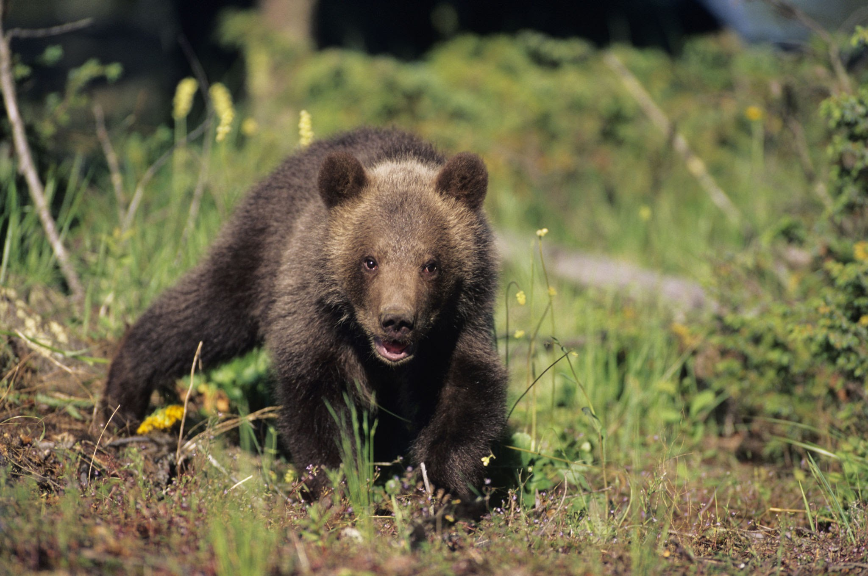
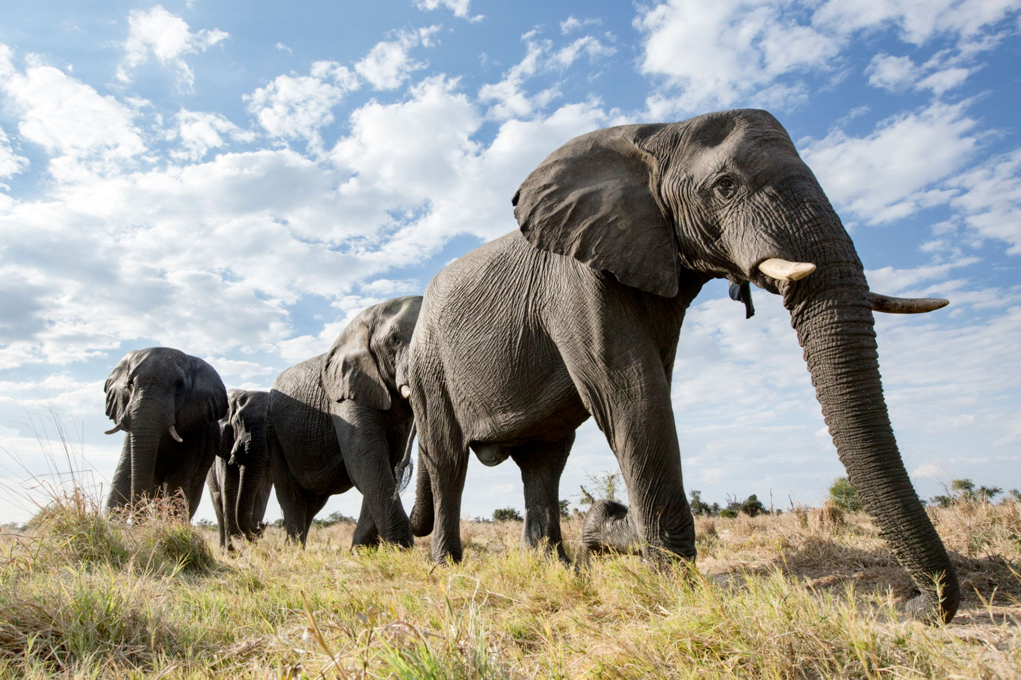
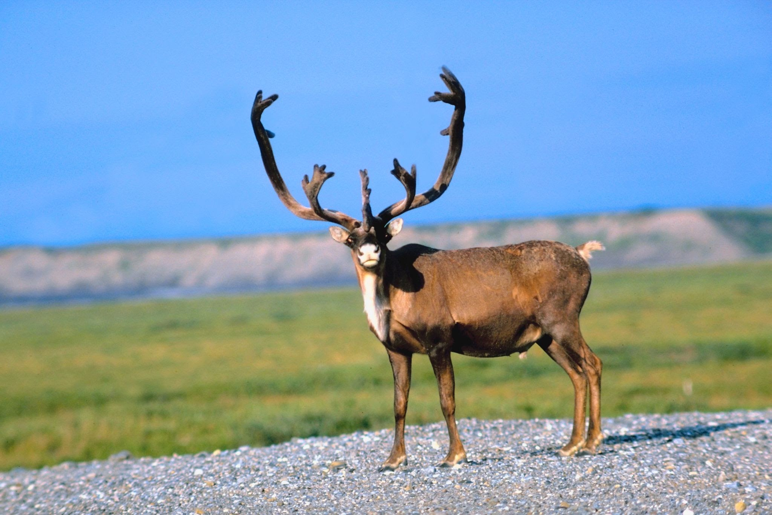
Elephants - Grizzly Bear - Caribou

