Slide 1
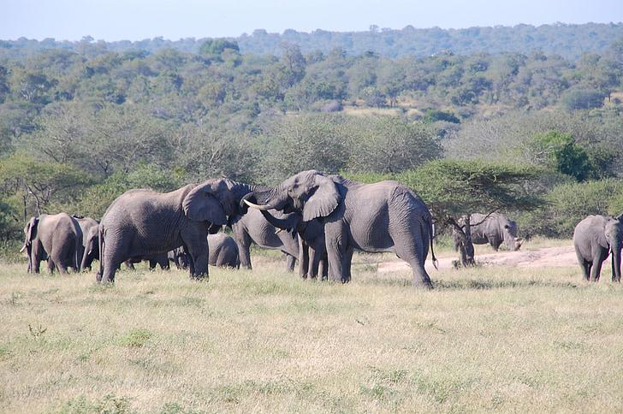


AI Digital 'Elephant Book' for Conservation
Elephanatics.org
Grade Level: Elementary (Grades 4-6)
Subjects: Technology, Language Arts, Science
Learning about Elephants & Technology

Slide 2
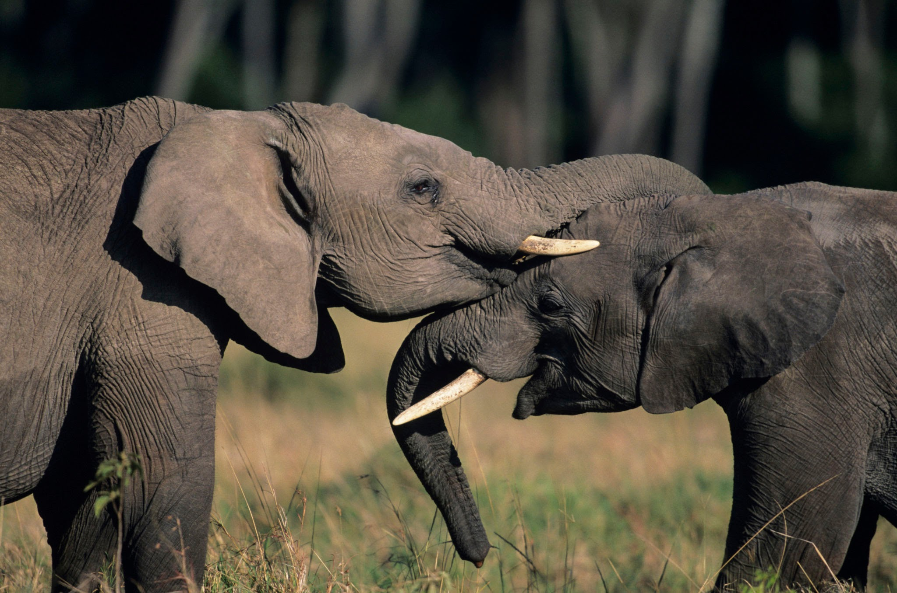
Our Learning Journey Today
Title: What Will We Learn?
Learning Objectives:
Understand the importance of elephant conservation.
Learn basic concepts of AI and its application in conservation.
Create a digital story about elephants using AI tools.
Develop digital literacy skills

Slide 3
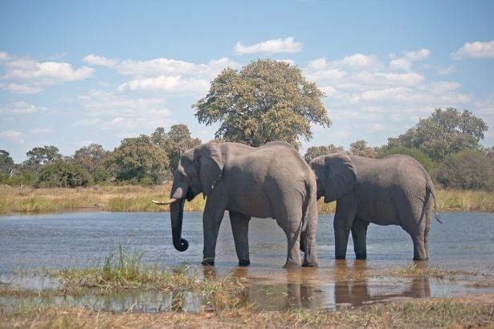
Why Elephants Matter! (Introduction - Part 1)
Title: Let's Talk About Elephants!
Discussion Points:
What do you know about elephants?
Where do they live?
Why are they important?
Visuals: Show captivating images and videos of elephants.
Key Idea: Emphasize their social behavior.
Notes:
Elephants are a key-stone species Female elephants are called Matriarchs African male elephants can weigh from 4,000-7,500 kg African female elephants can weight between 3,000-6,000 kg They live in the savannah regions of Africa and the Forest regions They are important for many reasons! - they are called a key-stone species because they are ecological engineers meaning they provide homes and create a healthy living environment for hundreds of other species. They are extremely important for biodiversity and help reduce the effects of climate change. Learn more at: https://elephanatics.org/biodiversity/

Slide 4
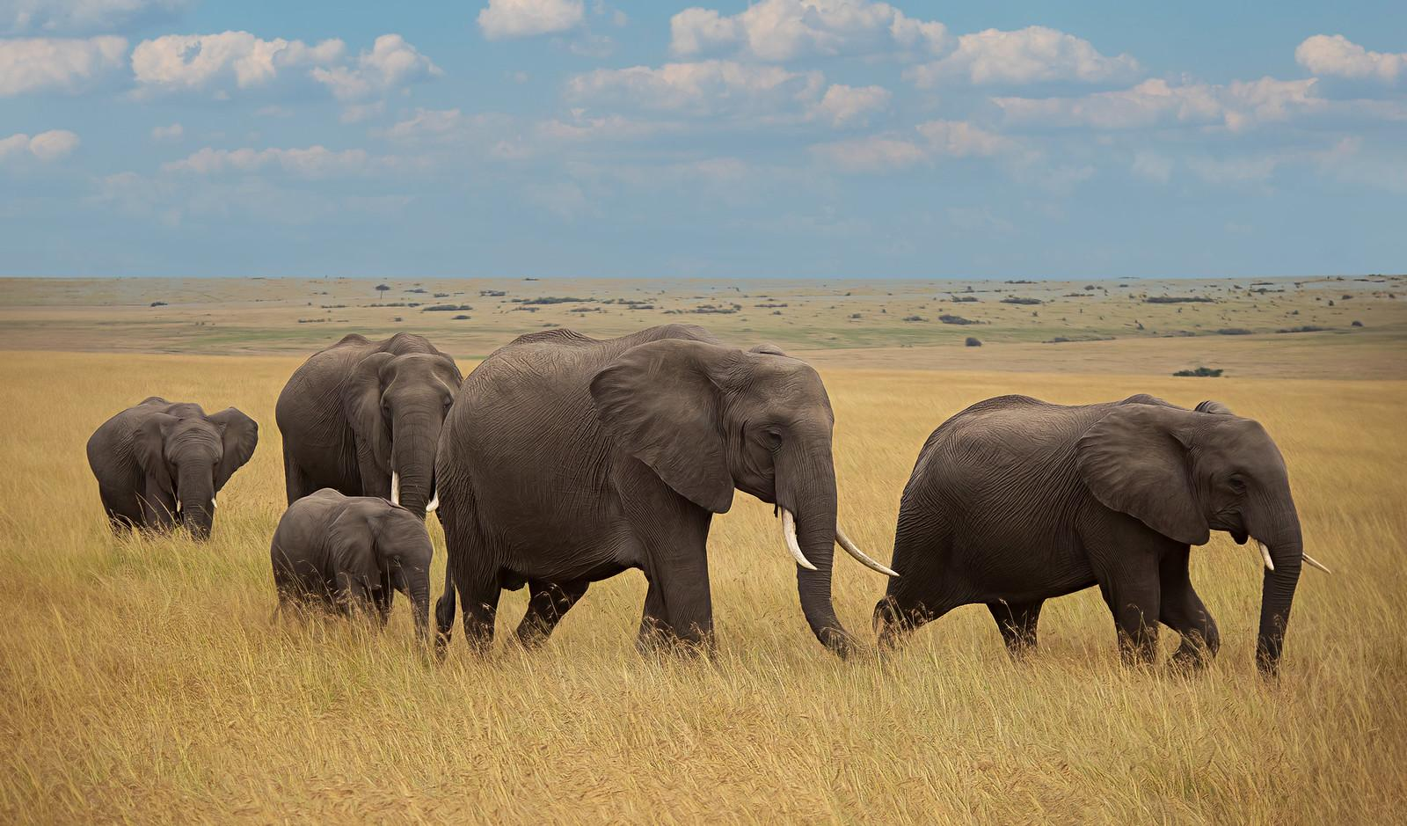
Social Behaviors and Communication of Elephants
Elephants use a variety of behaviors to communicate and maintain social bonds, including:
Tactile communication: Touching and caressing each other with their trunks and bodies.
Vocalizations: Using a wide range of sounds, from trumpeting to low-frequency rumbles, to communicate with each other.
Body language: Using their posture and movements to convey information and intentions.

Slide 5
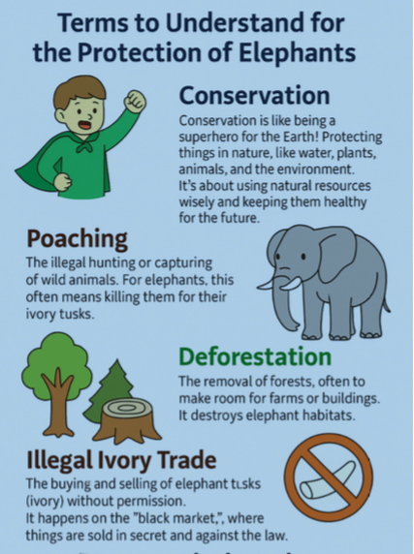
Challenges Elephants Face (Introduction - Part 2)
Title: Elephants Need Our Help!
Challenges:
Habitat Loss
Conservation
Poaching
Illegal Ivory Trade

Slide 6
Technology to the Rescue! (Introduction - Part 3)
Title: Technology & Elephant Conservation
What is AI?
AI helps computers create images and understand words, like a helper!
Mara Elephant Project (MEP) uses technology to help protect elephants such as EarthRanger and ElephantBook
EarthRanger as a central platform:
EarthRanger is used to track elephants, rangers, vehicles, and other assets, providing a unified view of their operations in the Greater Mara Ecosystem
The ElephantBook, is a software tool used for identifying and tracking individual elephants within a population. It helps to monitor the elephant population, track their movements, and assess their demographics. It also assists in identifying elephants that are injured or in conflict situations. Read more: https://maraelephantproject.org/mep-develops-elephantbook-to-automate-identification-of-elephants/

Slide 7
Creating Elephant Art with AI! (AI Image Generation)
Title: Our First AI Adventure: Image Creation!
Activity: You'll use an AI tool to create elephant images.
Example Prompts:
"An elephant in a savanna"
"A baby elephant playing"
"An elephant drinking water"
Why? These images will help us create our digital books!
Materials Needed: Computers/Tablets, AI image generation tools (e.g., Google ImageFX, Bing Image Creator)

Slide 8
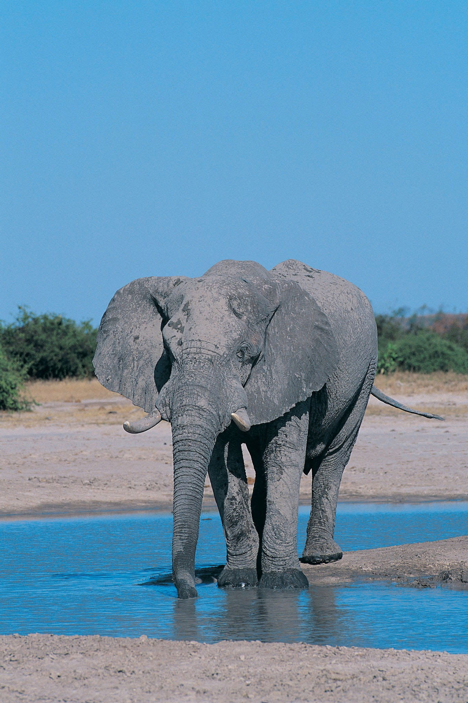
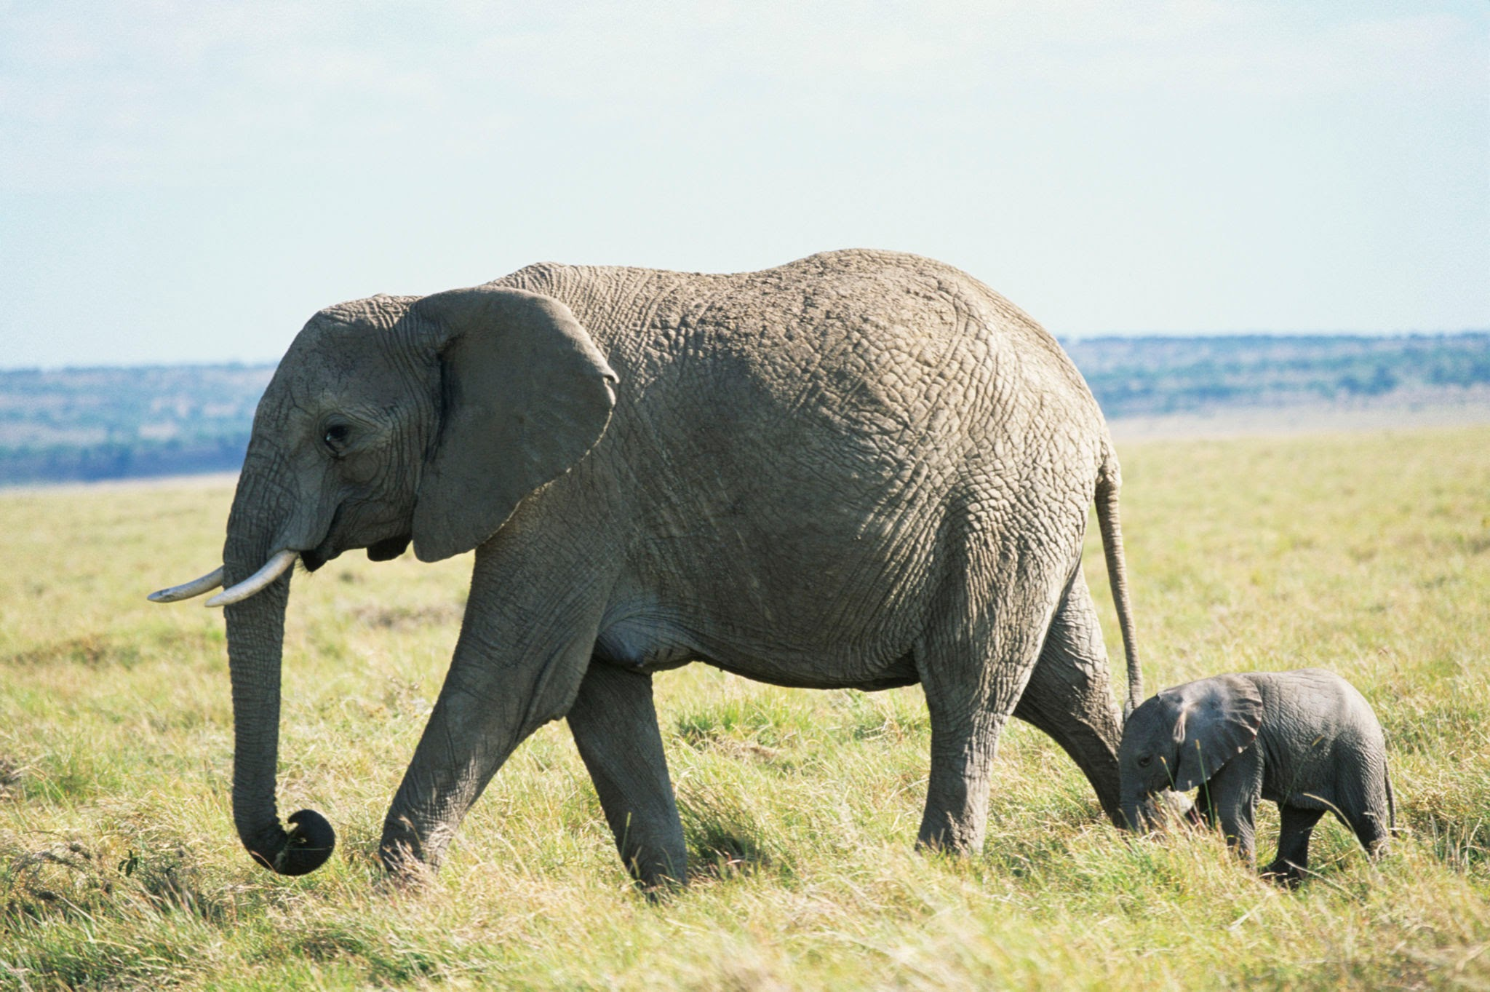
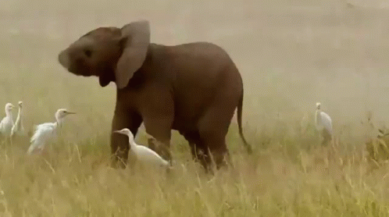
Example Prompts

Slide 9
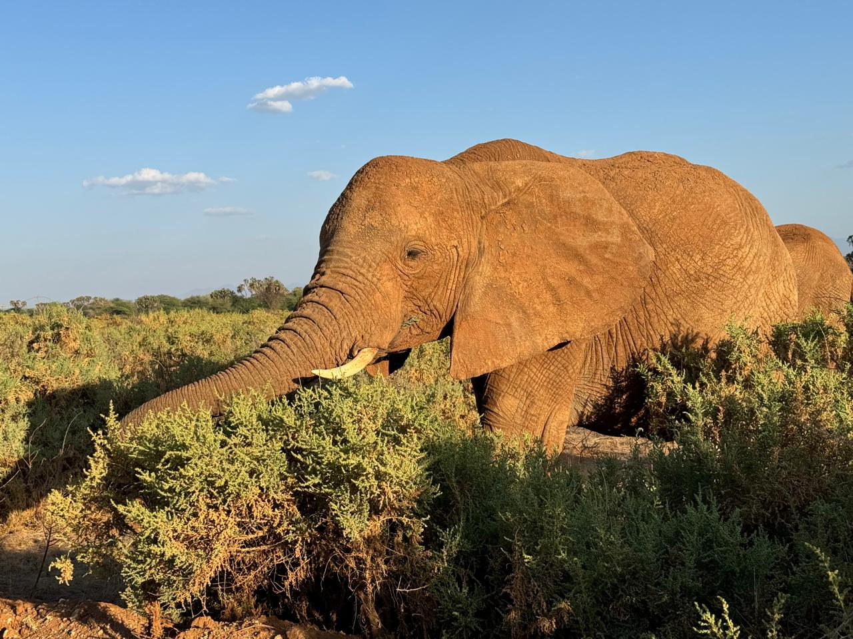
Telling Our Elephant Stories (Digital Storytelling - Part 1)
Title: Digital Storytelling: Creating Our Elephant Books!
Platform: We'll use a digital storytelling tool (like Google Slides or Canva).
How To:
Create slides or pages.
Insert your AI-generated elephant images.
Add text to tell your story.
Visuals: Screenshots or examples of the digital storytelling platform.

Slide 10
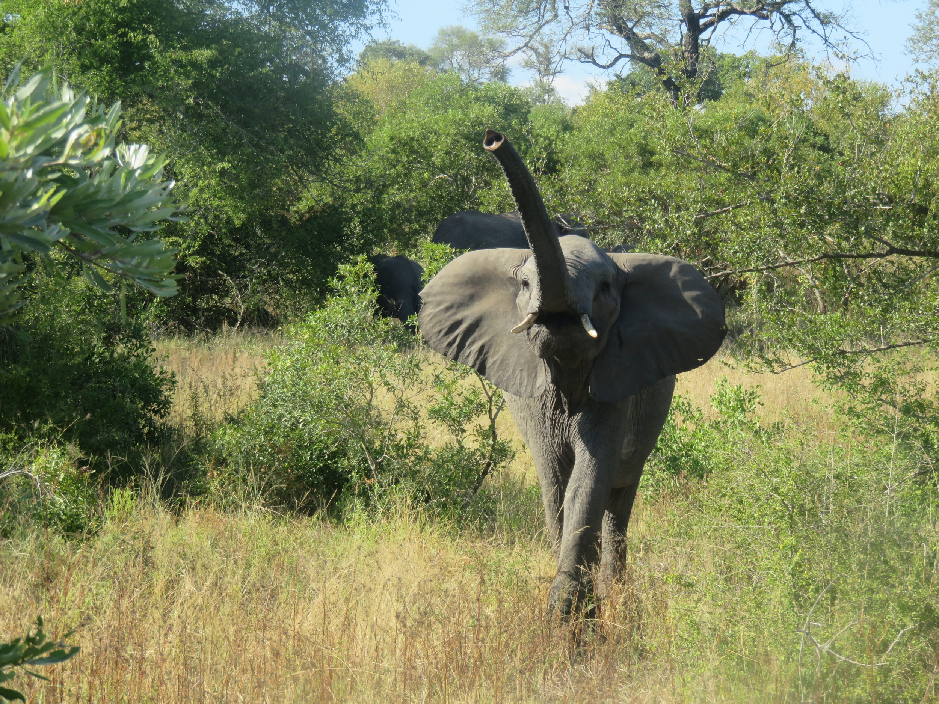
What Makes a Great Elephant Story? (Digital Storytelling - Part 2)
Title: Your Story's Focus:
Key Elements:
Elephant behavior
Conservation messages
Facts about elephants
Example Story Ideas:
"The journey of a baby elephant"
"How people are helping the Elephants"
Remember: Your stories help others learn!

Slide 11
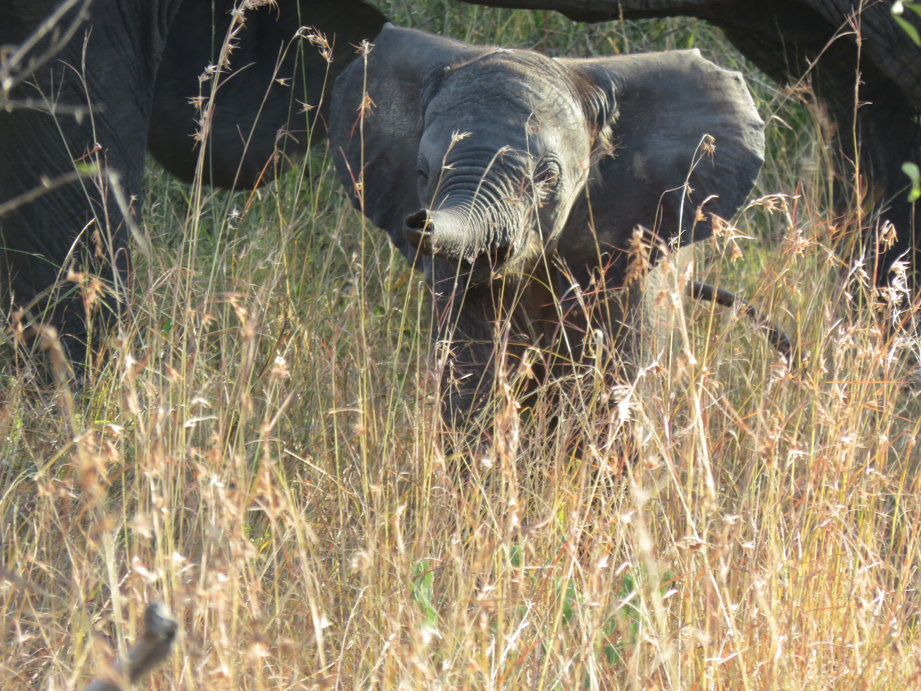
What We Learned (Assessment & Review)
Title: Our Elephant & AI Learning!
We Assessed Your Learning By:
Observing your participation and engagement.
Reviewing your digital elephant books for content and creativity.
Assessing your understanding of elephant conservation and AI.

Slide 12
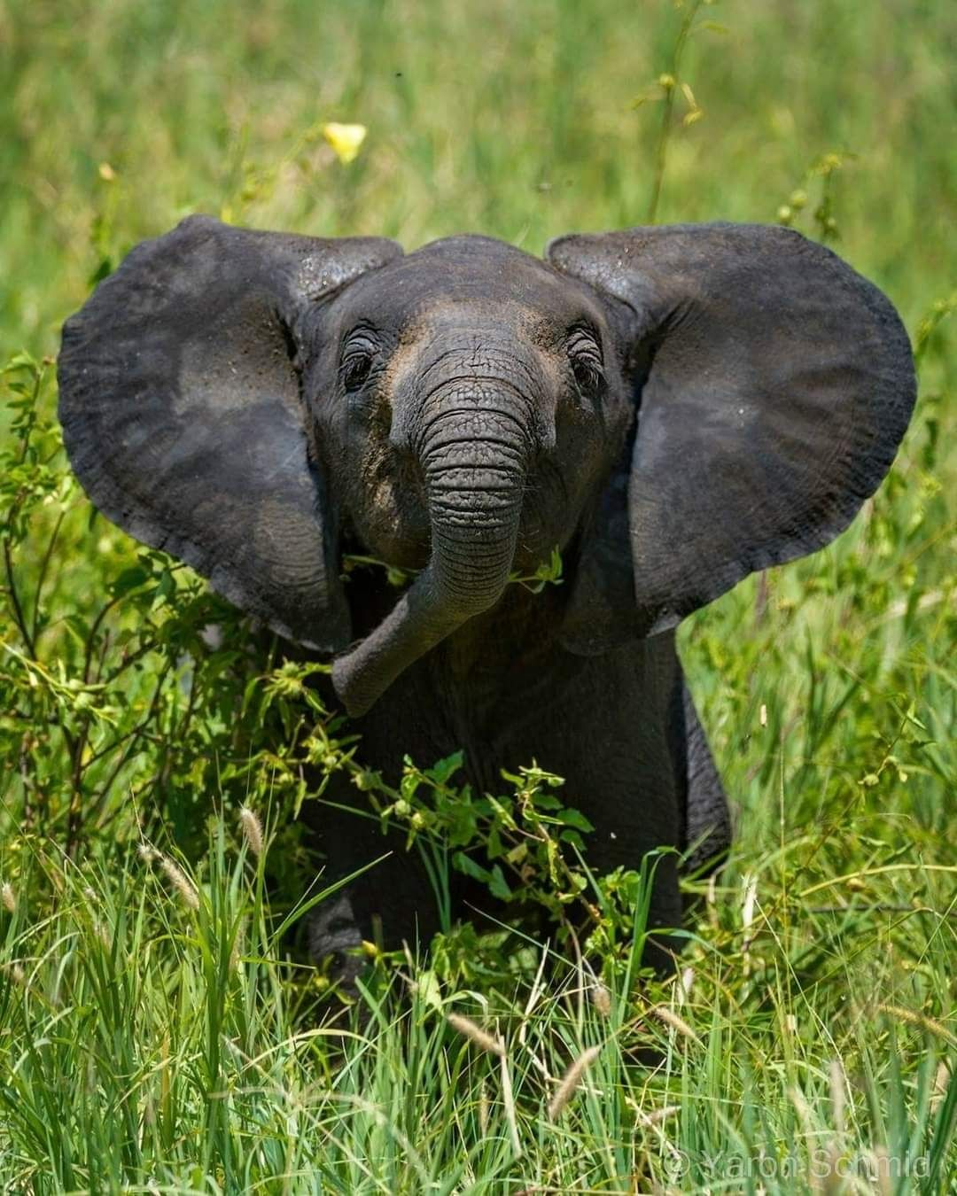
Share Our Stories & Reflect! (Sharing and Reflection)
Title: Share & Learn Together!
Activity: Share your digital elephant books with the class.
Discussion Questions:
What did you learn about elephants?
How can we help protect elephants?
How can technology help animals?
Recall: How Mara Elephant Project uses technology to track and protect elephants.

Slide 13
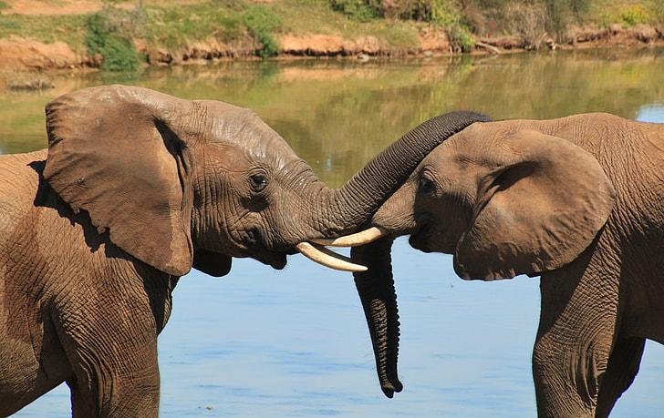
More Elephant Adventures! (Extension Activities)
Title: Want to Do More?
Ideas for
Fun:
Research other animal conservation projects using tech.
Create a class presentation about elephant conservation.
Write letters to conservation organizations.

Slide 14
Chat with Mara the Elephant!
Title: Chat with an African Elephant on a Platform You Love!
Imagine: If an elephant could speak, what would they say?
Meet Mara: You and your family can chat with "Mara" the elephant on Messenger, thanks to AiNi!
Mara Will:
Share stories about her and the herd's life.
Answer questions about African elephants and conservation.
Test your knowledge with quizzes and trivia.
Support Conservation: When you subscribe, a majority of proceeds support Mara Elephant Project's conservation work!
How to Connect: Go to Mara's Facebook Page on your app and tap the "Message" button. https://www.facebook.com/profile.php?id=61565139880930

Slide 15
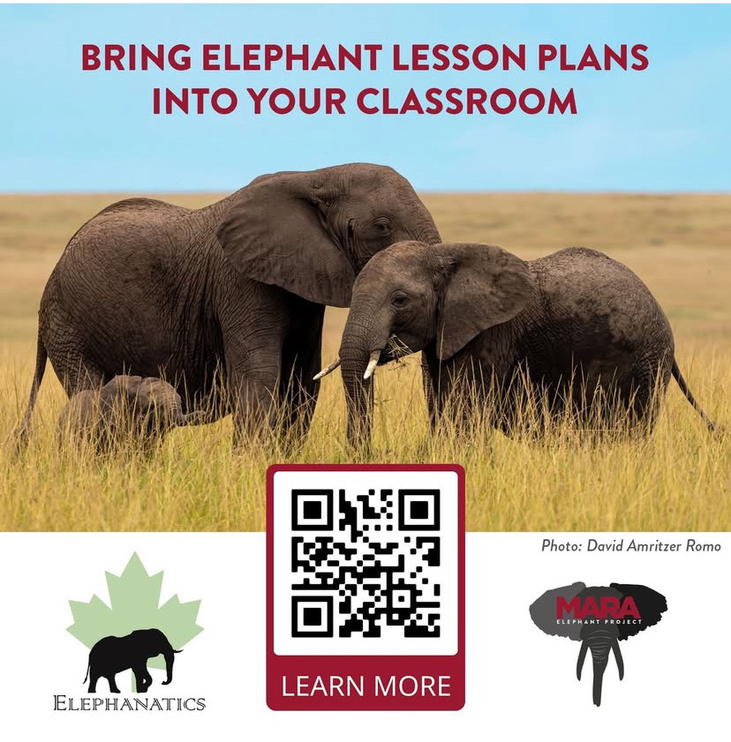
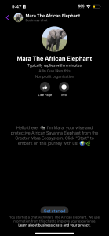
Exciting Resources For Students!

