Slide 1
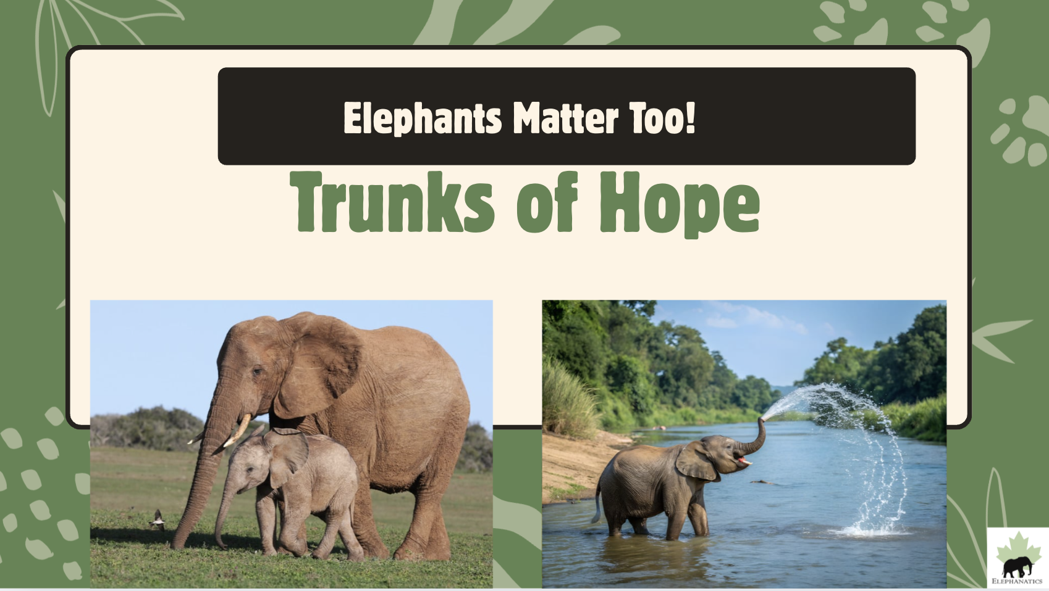
Notes:
Elephants Matter Too! Trucks of Hope... Today we will learn how elephants help our world! And you will get an opportunity to make a difference in our world too!

Slide 2
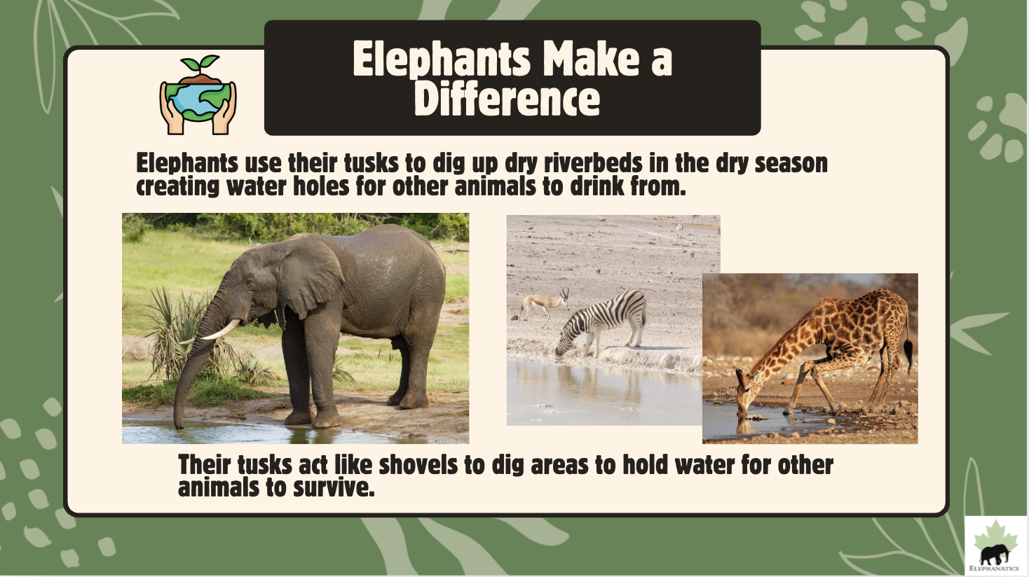
Notes:
Elephants use their tusks to dig up dry riverbeds in the dry season creating water holes for other animals to drink from.
Their tusks act like shovels to dig areas to hold water for other animals to survive.
Have you ever dug up a moat around a sand castle to bring water around it on the beach? Elephants can dig really well with their white tusks to find water under the dirt, and then other animals and people can drink the water. They are called 'watering holes. We need water to survive.

Slide 3
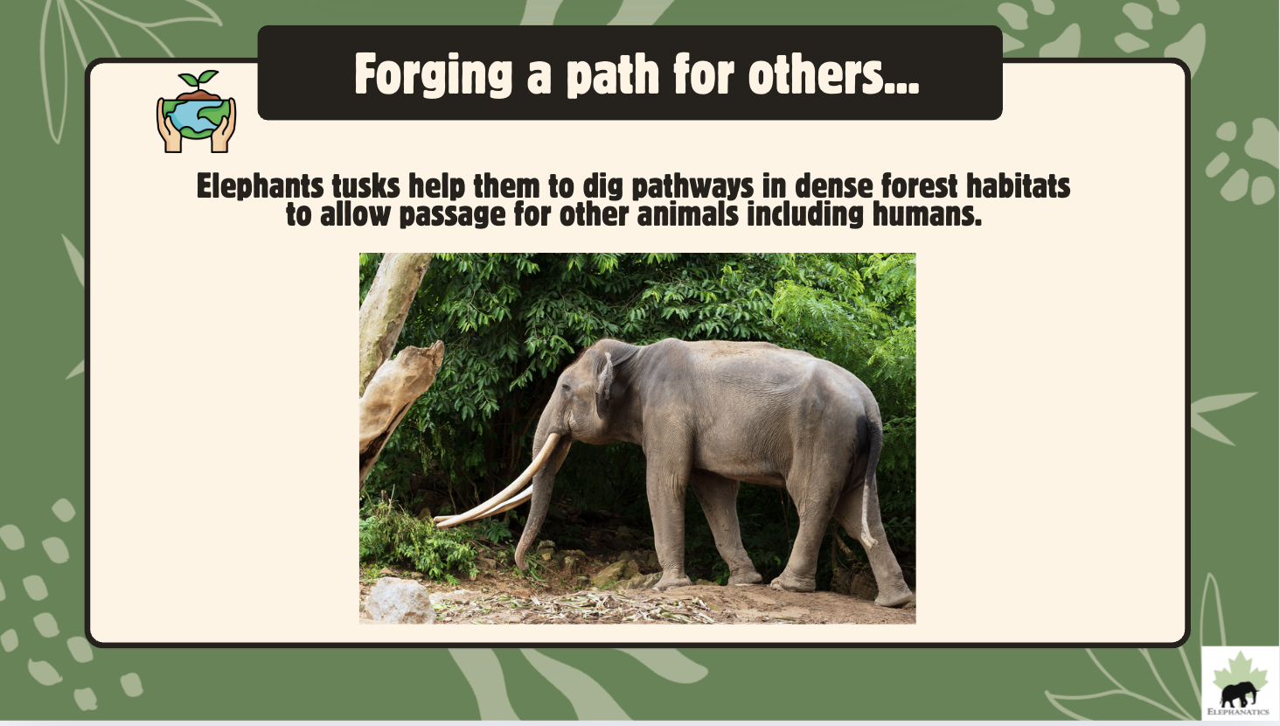
Notes:
Elephants tusks help them to dig pathways in dense forest habitats to allow passage for other animals and humans. We need elephants to create a path to get through the forest to find food and water to survive.

Slide 4
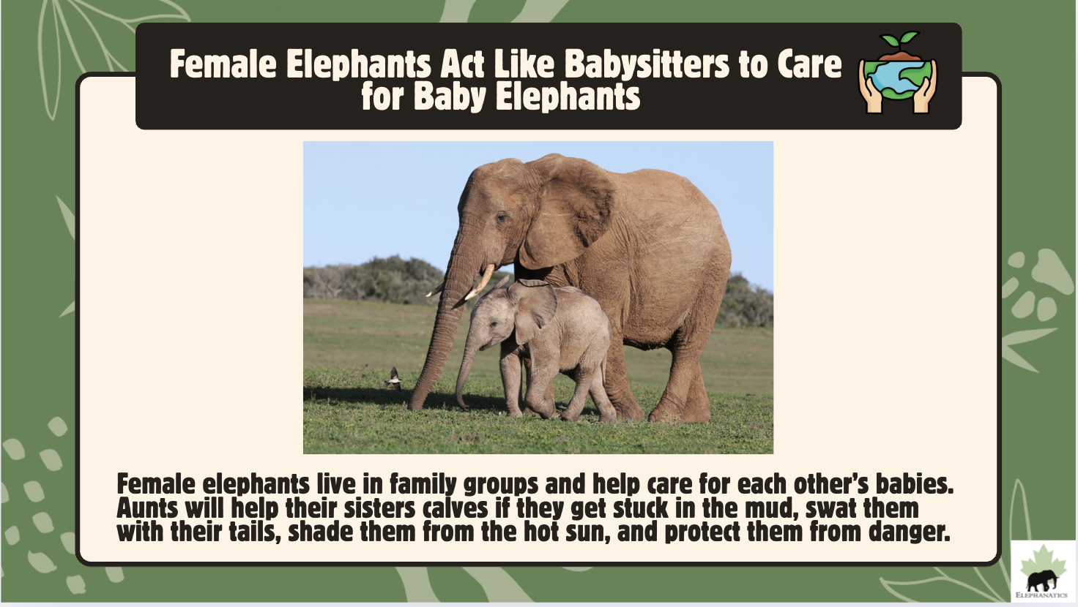
Notes:
Female Elephants Act Like Babysitters to Care for Baby Elephants:
Female elephants live in family groups and help care for each other’s babies. Aunts will help their sister’s calves if they get stuck in the mud, swat them with their tails to get rid of insects, shade them from the hot sun, and protect them from danger.

Slide 5

Elephants Never Forget
Notes:
Why are elephants so important to our world?
Let's watch part of this video: Elephants Never Forget to learn more. (6 minutes total excerpts)
*Watch from 1:00- 7:00 minutes.
Elephants ears help fan them and other animals to keep cool. The wrinkles on their skin help hold water to keep them cool on a hot day- like when you cool off with a sprinkler outside when it gets really hot. Can you believe one African elephant can weigh as much as 6 cars or 80 people! Their trunks help clear a path in the forest. Elephants make loud trumpeting sounds to warn other animals of danger to protect them. Elephant poop is very important. Elephants eat fruits and vegetables and the seeds pass through into their poop- then the dung beetles push the poop and new seeds are planted to grow! One third of some plants and trees would die out in some areas if the elephants were not around to eat and poop out the seeds for new growth! Elephants provide transportation and help carry things. Elephants are very important. They are endangered and need our help to protect them.
**Skip to final section: 17:50- 18:36: Conservation groups: protect elephants like svavo national park. Don't forget the elephants- they need our help! They do so much to help our world!

Slide 6
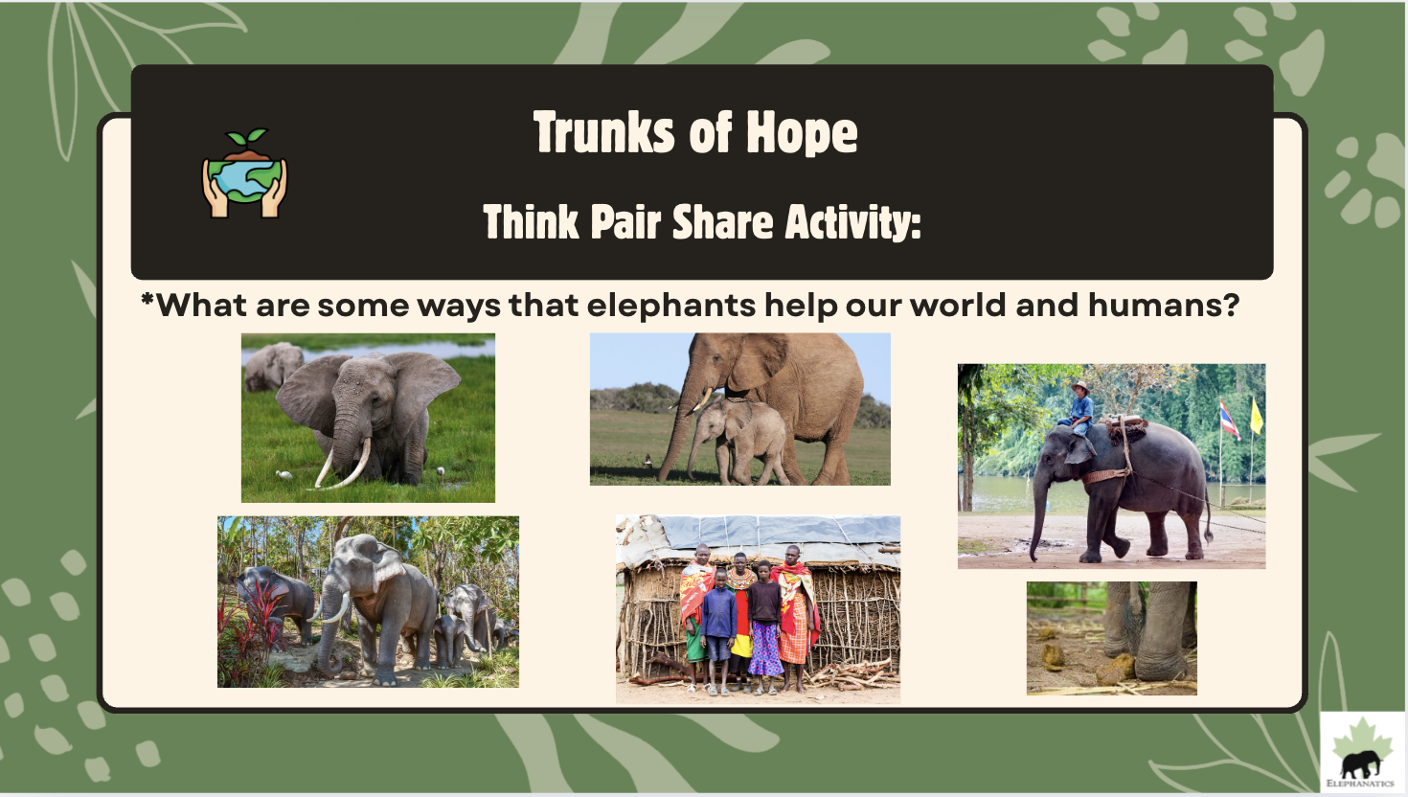
Notes:
Trunks of Hope: Think Pair Share Activity:
"What are some ways that elephants help our world and humans?" Elephants play a big part in our world. Elephants are needed for other animals and humans' survival.
Look at the pictures- what are some ways elephants help us that we learned about in the video... (answers on next slide)

Slide 7
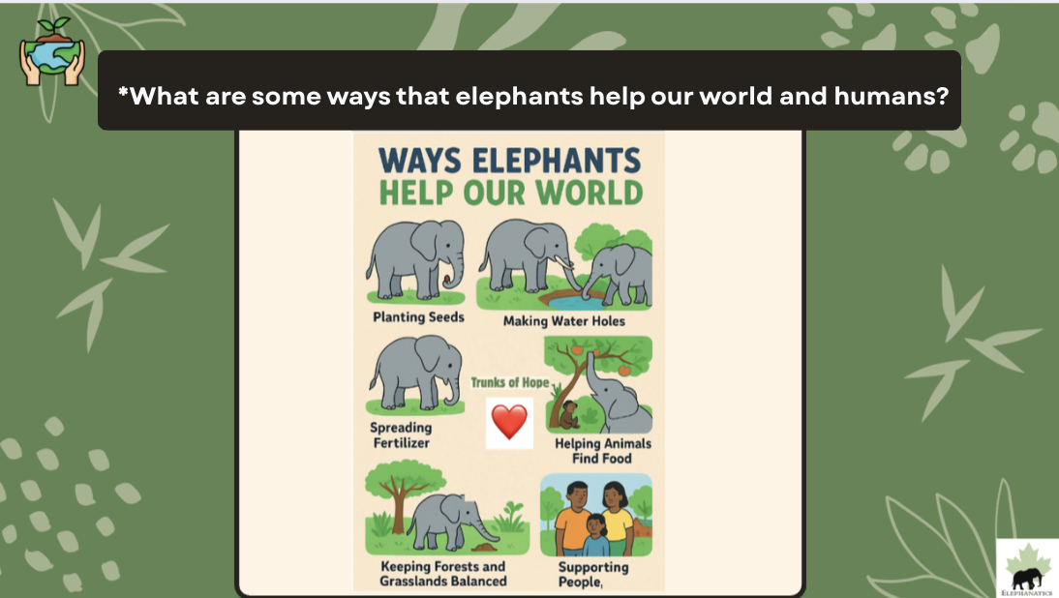

Notes:
"What are some ways that elephants help our world and humans?" Elephants play a big part in our world.
1. Plant seeds
2. Make watering holes
3. Spread fertilizer to help plants and animals through their poop
4. Help reach find food for animals.
5. Keeping forests and grasslands balanced
6. Elephants support people by providing fresh air and water, and making paths in the forest and providing transportation.

Slide 8
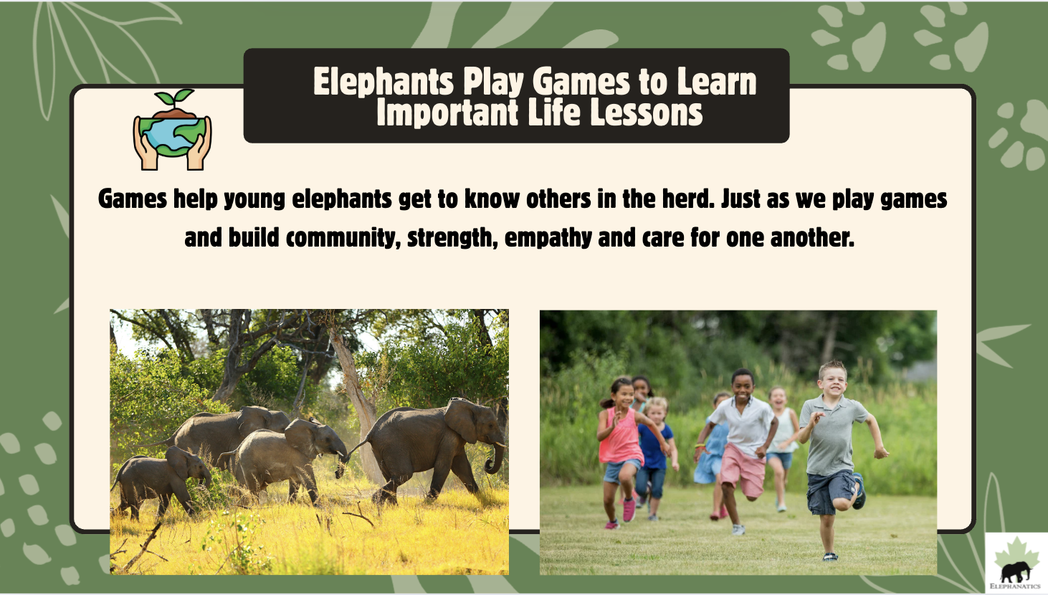
Notes:
We have a lot in common with elephants:
We have a lot of empathy and care for one another. We are building community in our classroom, just like elephants are building community in their herd as they care for one another and our world.
Optional: take a brain break and play a community building game, such as Simon Says or let teams create a team handshake, do a go noodle team exercise.

Slide 9
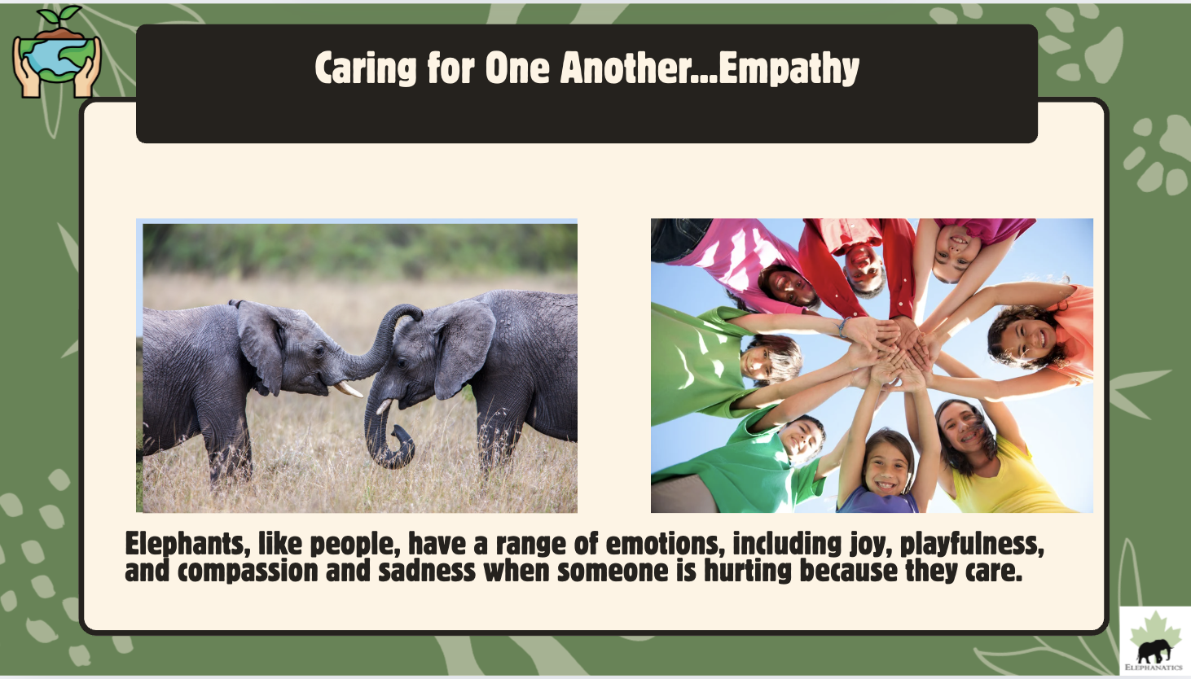
Notes:
Elephants, like people, have a range of emotions, including joy, playfulness, and compassion and sadness when someone is hurting because they care.

Slide 10
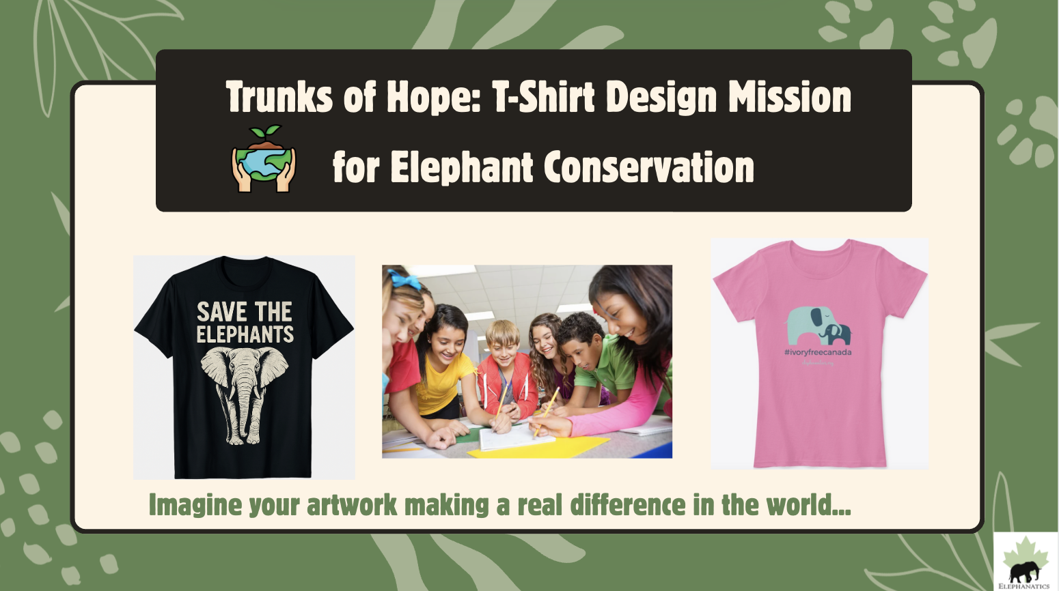
Notes:
Imagine your artwork making a real difference in the world... here is one way we can make a difference but letting others know that elephants need to be protected. Elephants are critically endangered.
"Elephants have decreased by nearly two-thirds largely because of human activities in past 40 years."
How can we help the elephants: today we will design t-shirts to teach the world about the importance of protecting the elephants.

Slide 11
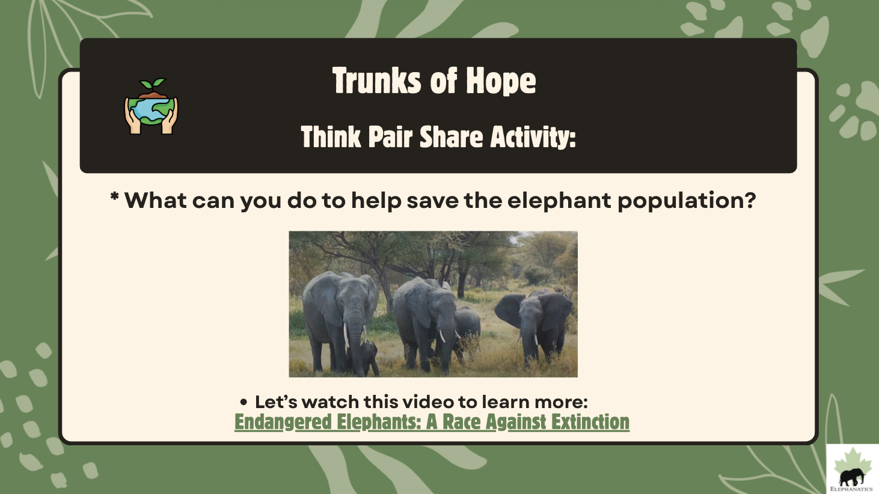
Endangered Elephants Video Link
Notes:
Think Pair Share Activity: What can you do to help save the elephant population to help our world?
Watch video: 1:47-2:47
Optional:
Brainstorm ways to help: (possible ideas: Educate others how important elephants are with posters, video, presentation, announcement at school with Elephant Conservation Event: Fun Run to Raise Money for Conservation Efforts, Bake Sale, Posters at School, Create our own Video to share important information, Share slide show with other classes, Share an Elephant book or video, Write our government letters and ask them to protect elephants from poachers, Join T-shirt Contest and create a Conservation T-shirt to raise awareness, Book marks, Posters, & hats with original art work, add books about elephants to our library...brainstorm other ideas.

Slide 12
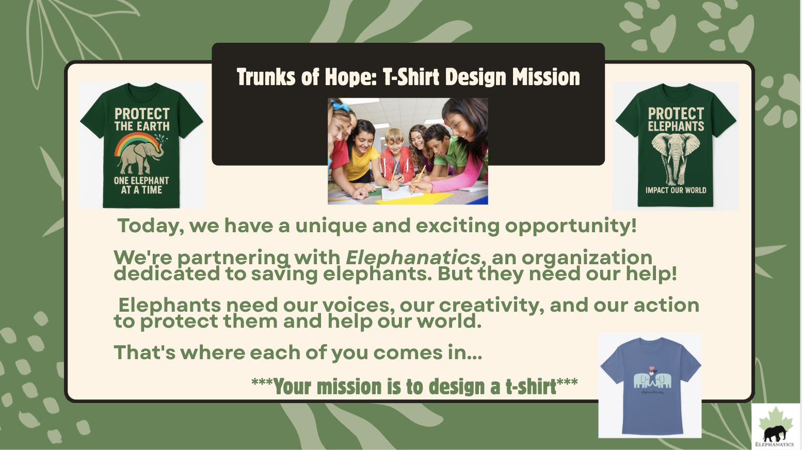
Notes:
Today, we have a unique and exciting opportunity!
We're partnering with Elephanatics, an organization dedicated to saving elephants. But they need our help!
Elephants need our voices, our creativity, and our action to protect them and help our world.
That's where each of you comes in...
***Your mission is to design
a t-shirt***
Here are some examples of slogans on t-shirts:
-Protect the Earth- One Elephant at a Time
-Protect Elephants: Impact our World
-Save the Elephants

Slide 13
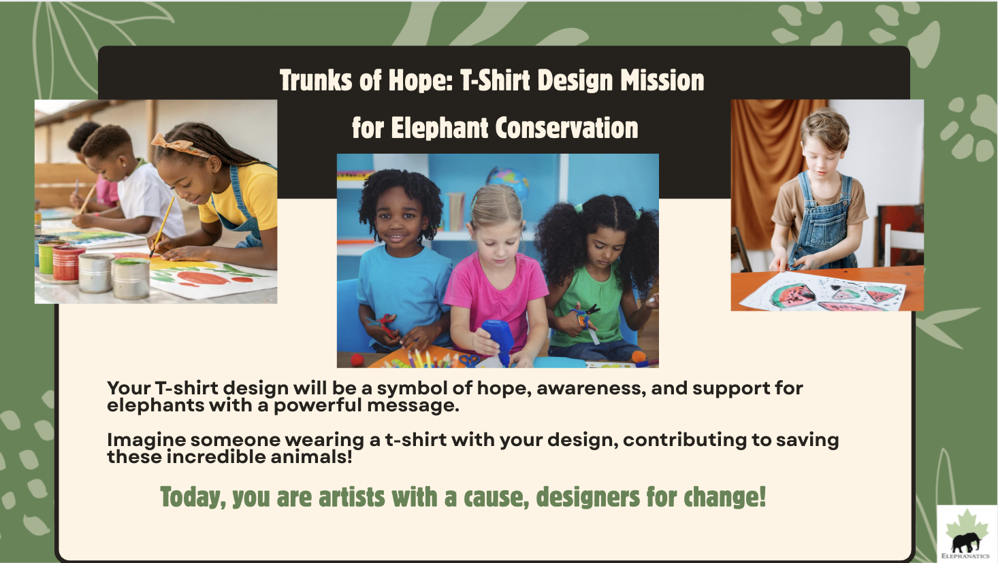
Notes:
Your T-shirt design will be a symbol of hope, awareness, and support for elephants with a powerful message.
Imagine someone wearing a t-shirt with your design, contributing to saving these incredible animals!
Today, you are artists with a cause, designers for change!

Slide 14
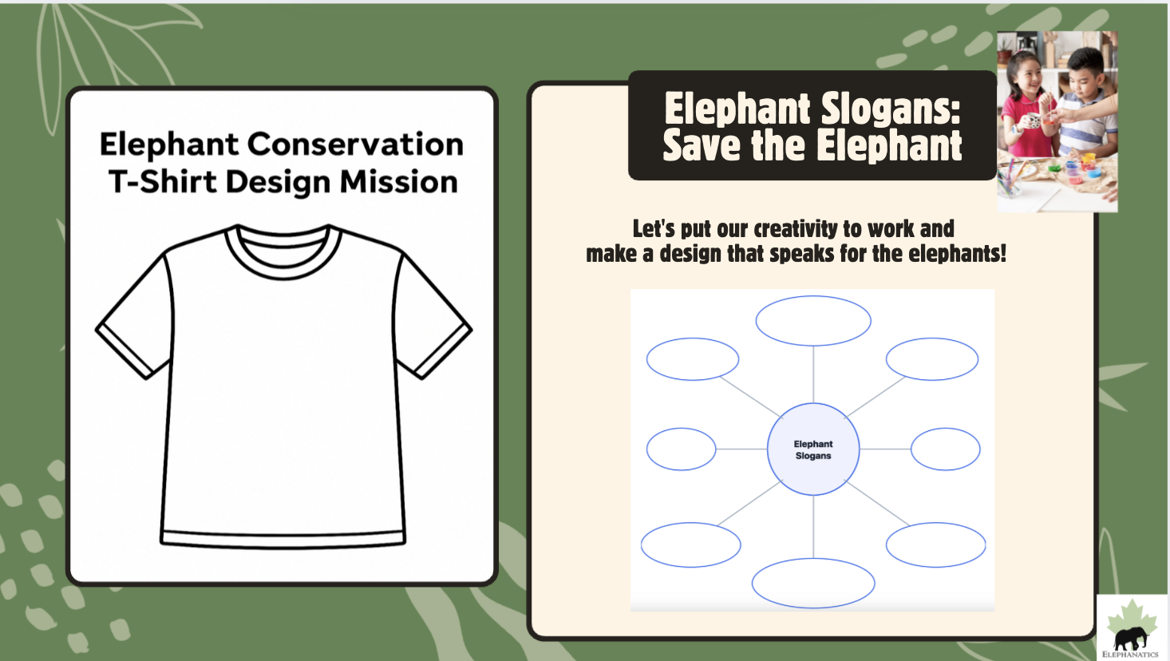
Notes:
Let's put our creativity to work and make a design that speaks for the elephants!
Think Pair Share:
Brainstorm slogans or mottos that we could put on a t-shirt, different images and colors students could use.
For example: Save the Elephants, Our World Needs Elephants, Help Now, Elephants for Earth Day... (think about alliteration, catch phrase, heartfelt message, action verb, rhyming words...
*Ask students what colors, images, shapes, pictures do they imagine

Slide 15
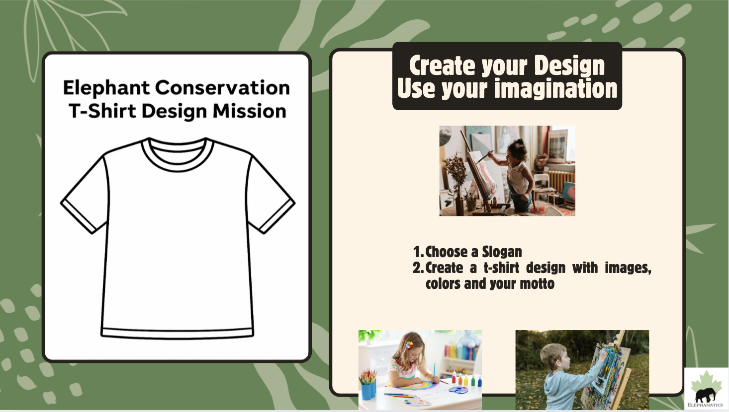
Notes:
* Organize Small Group Teams:
-Let teams choose a slogan.
- Provide paper and pencils for students to jot down or sketch their initial ideas.
(Elephant worksheets provided with pictures of elephants students can use if they want or they can draw their own pictures).

Slide 16
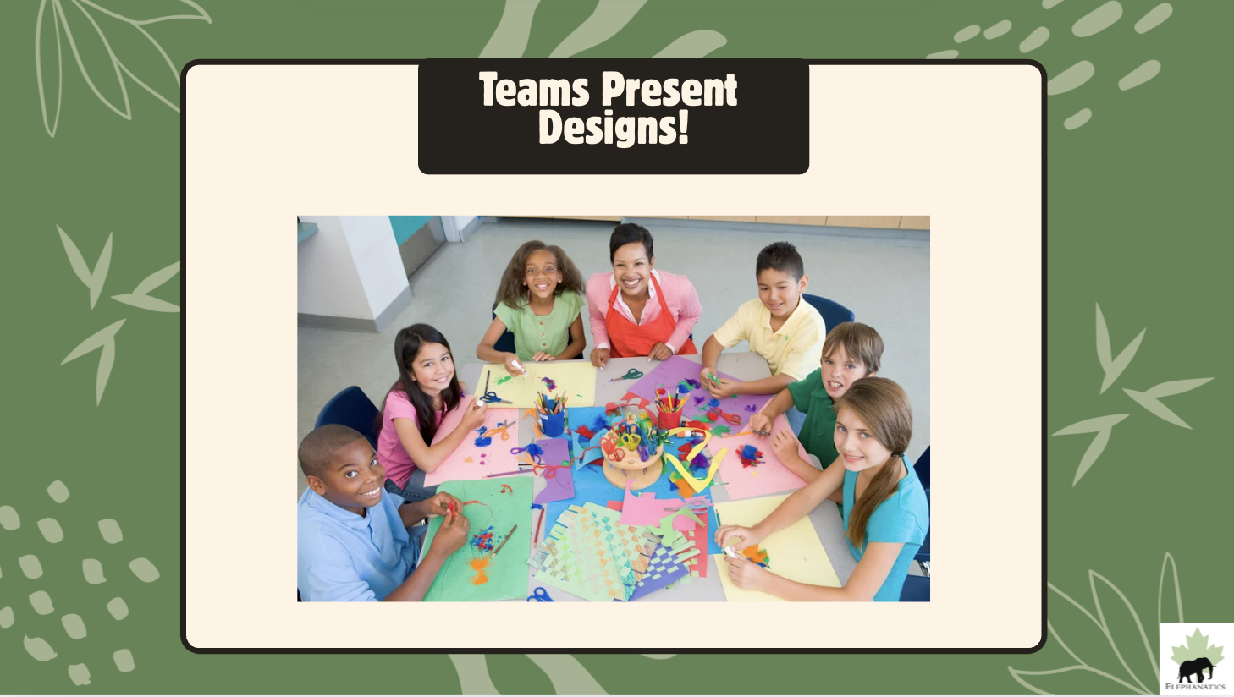
Notes:
Team Presentations:
o Each team presents their t-shirt design to the class
• Optional Voting for the Final Design:
After all teams have presented, conduct a voting session to select the design that will represent the class
and be shared with Elephanatics.
* Announce the winning design to the class, acknowledging the team’s effort and creativity, and submit the design to Elephanatics.

Slide 17
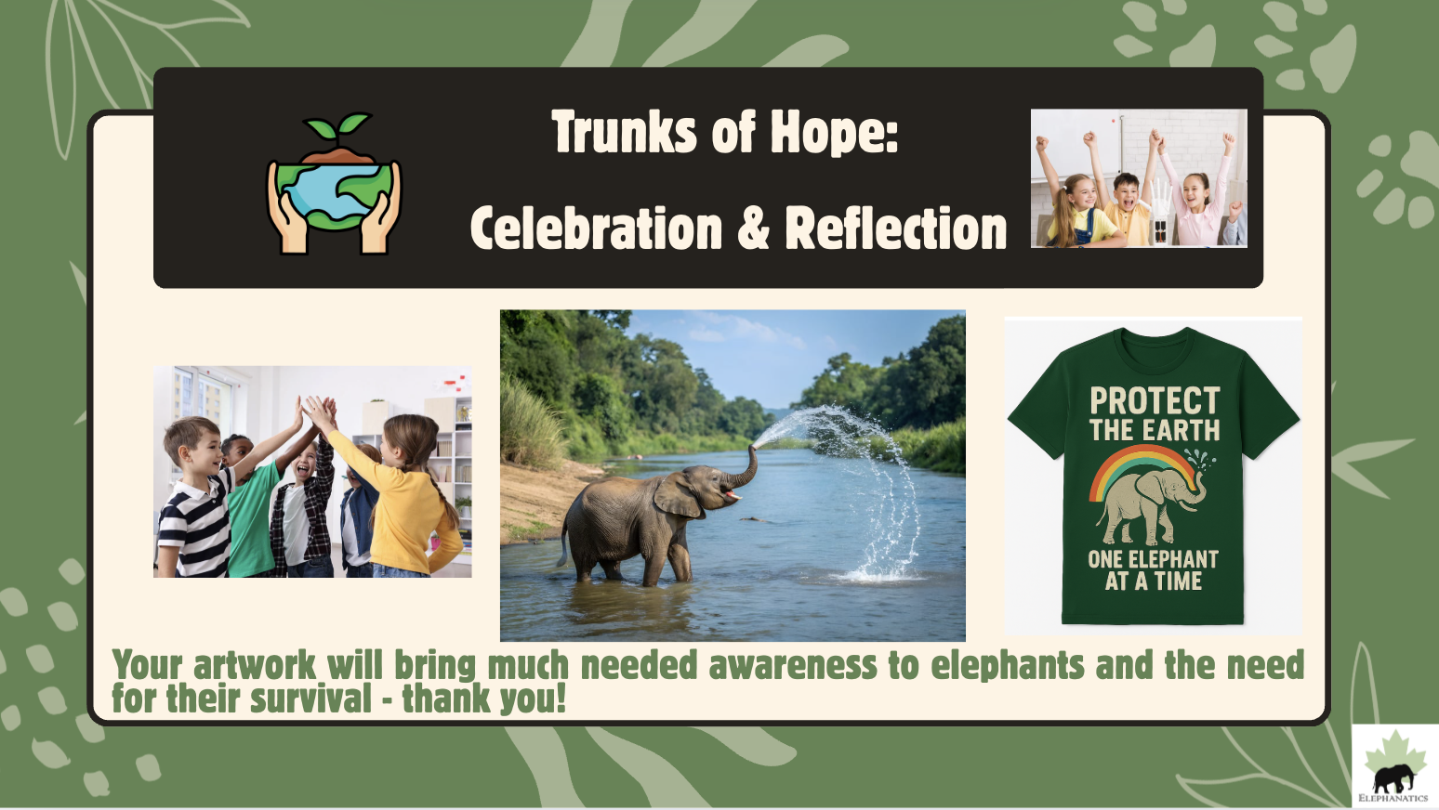
Notes:
Conclude with a ‘Reflective Sharing’ Activity:
• Reflection: Have students individually reflect on the importance of elephant conservation, focusing
on what they've learned and why the cause matters.
• Group Sharing: Organize a circle for students to share their thoughts. Encourage concise statements about the
significance of saving elephants and additional conservation efforts.
• Optional Explore Further Actions: Utilize other lessons and resources to explore other way to contribute to elephant conservation.

Slide 18
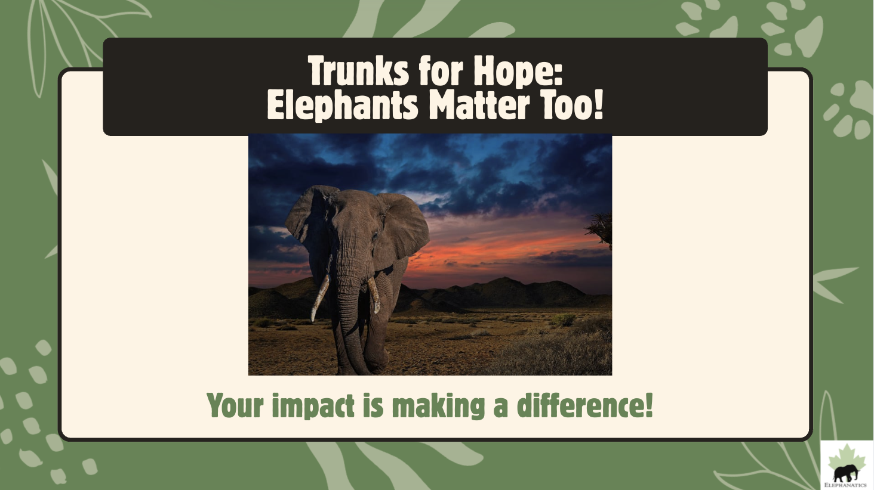
Notes:
Your impact is making a difference! Trunks for Hope- Elephants Matter Too! *Optional: Check out Elephanatics.org for more ideas for your classroom to get involved in other Conservation Projects with lots of free resources and lessons.
Also note these important dates for possible activities and events on these days:
August 12: World Elephant Day: An international event dedicated to the preservation and protection of elephants.
March 3: World Wildlife Day: This UN-designated day celebrates the world's wild animals and plants. It is an excellent opportunity to highlight elephants as a key species and "ecosystem engineer," and to talk about their interconnectedness with other wildlife.
March 21: International Day of Forests: Elephants, particularly Asian and African forest elephants, are critical to forest ecosystems. This day is perfect for discussing how habitat loss and deforestation directly impact elephant populations and the importance of forest conservation.
May 22: International Day for Biological Diversity: . Elephants are considered a keystone species, so this is a great day to talk about the vital role they play in maintaining healthy ecosystems.
June 5: World Environment Day: A global day to raise awareness and action for the protection of our environment.

