Slide 1
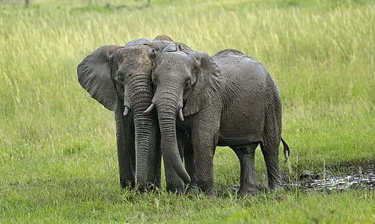

Exploring Geospatial Analysis and
Conservation Strategies
Technology and Conservation: Saving Elephants in the Mara

Slide 2
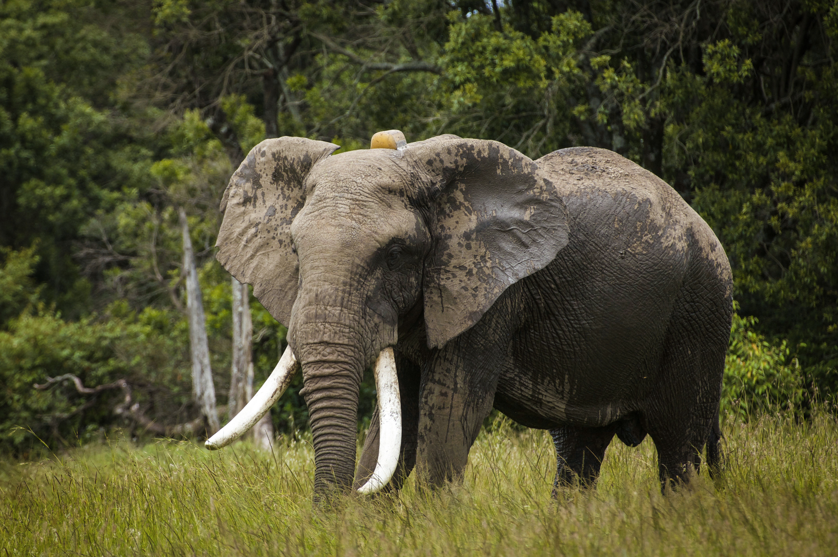
A Lesson in Geospatial Analysis and Community Action
A collared elephant
Masai Mara, Kenya

Slide 3
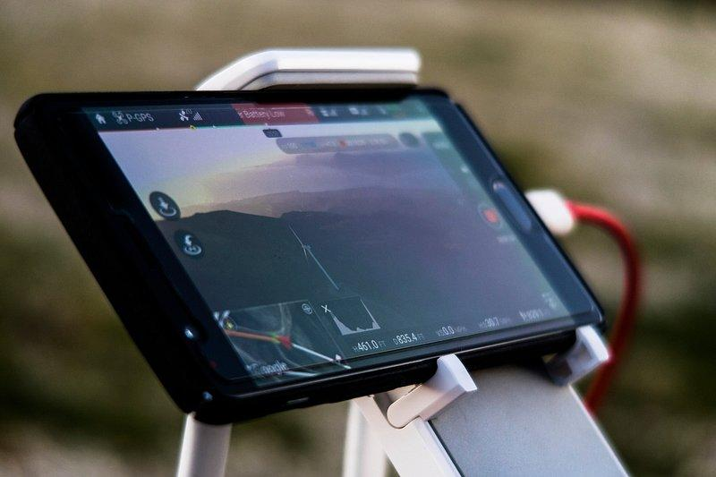
How does technology help save wildlife?
Wildlife conservation now depends on advanced technology.
We can track and protect animals in a new, powerful way.
It's a way to connect with communities and solve conflicts.

Slide 4
OUR GOALS
By the end of this lesson, you will be able to:
Understand how technology is used to monitor wildlife.
Explain the role of geospatial analysis in conservation.
See the link between technology, conservation, and communities.

Slide 5
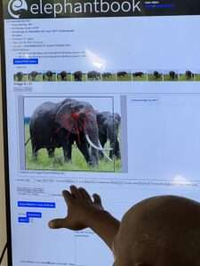
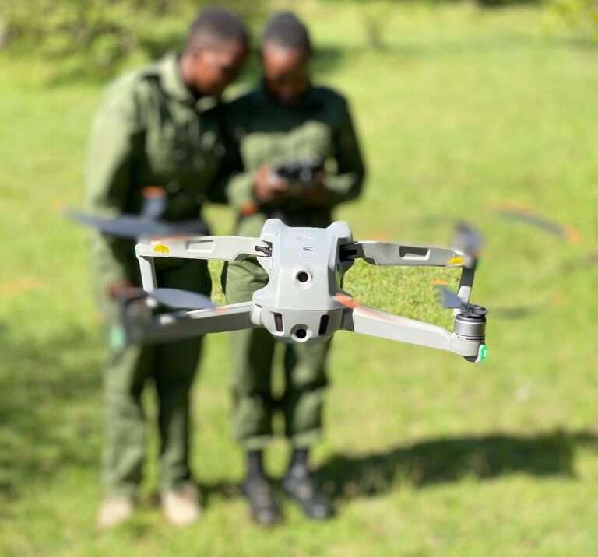
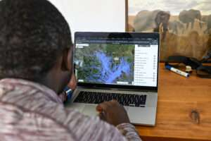
A Real-World Case Study
The Mara Elephant Project
Located in the Mara ecosystem in Kenya.
Uses GPS collars to track elephants in real-time.
Uses a system called EarthRanger to view data and predict movement.
Works with local communities to reduce human-elephant conflict.

Slide 6
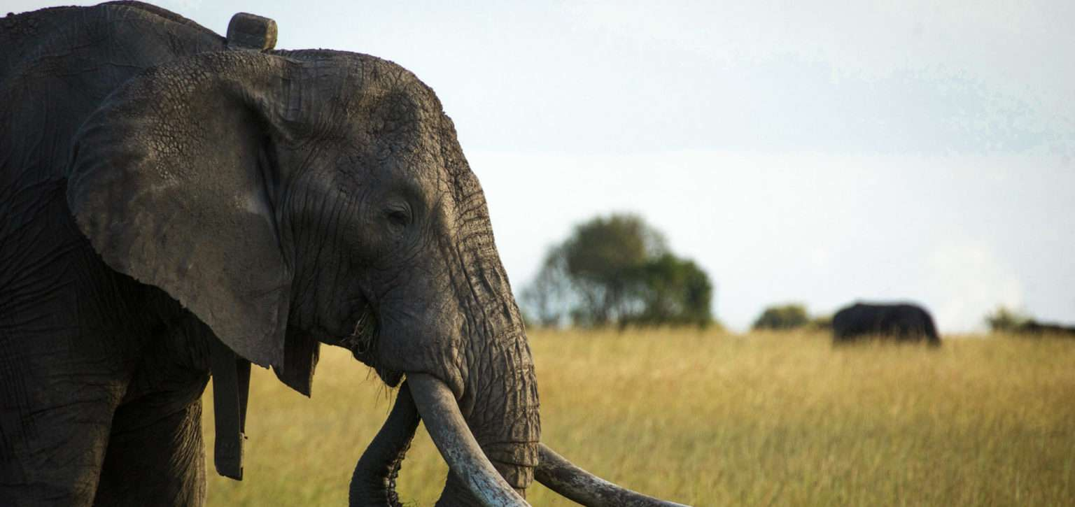
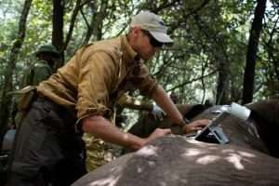
HANDS ON AND CREATIVE
Become a Conservation Designer
Activity 1: Create a Collar. Design your own elephant tracking collar with new tech features.
Activity 2: Role-Play. Step into a real-world conflict scenario and find solutions with technology.

Slide 7
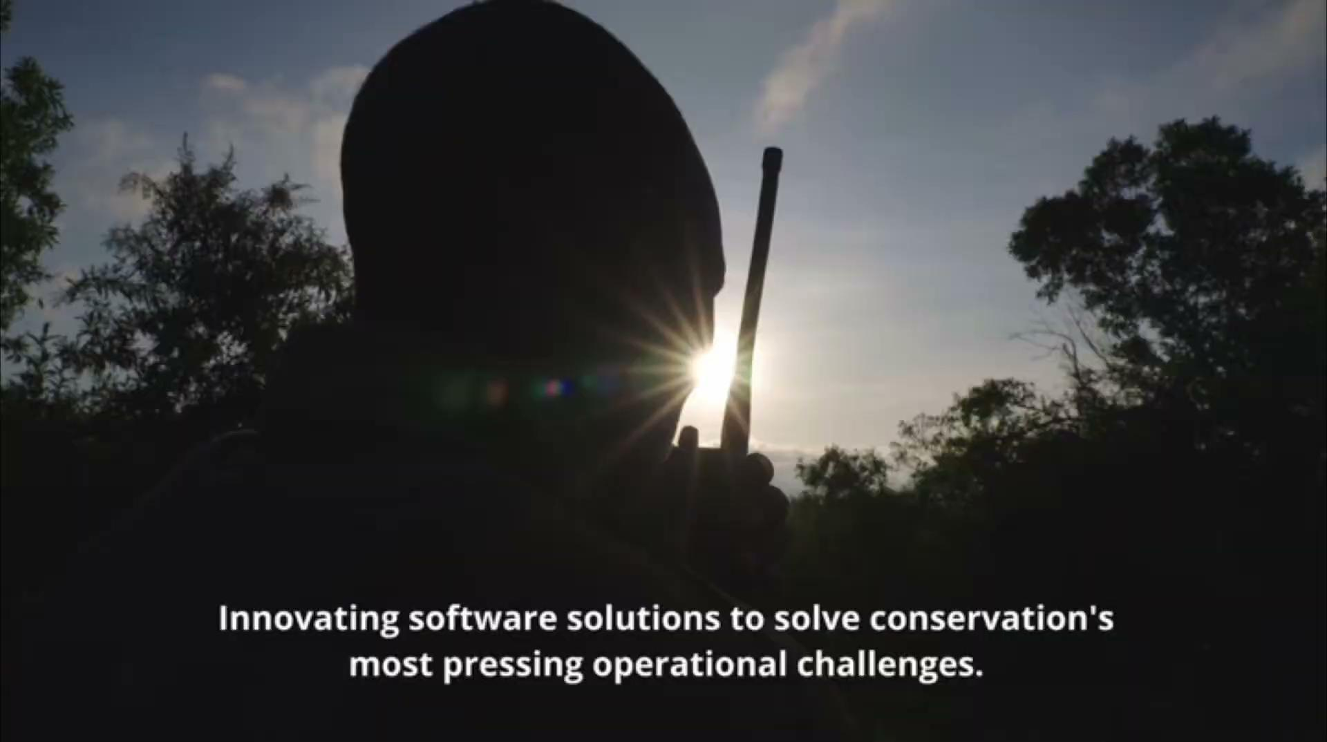

Slide 8
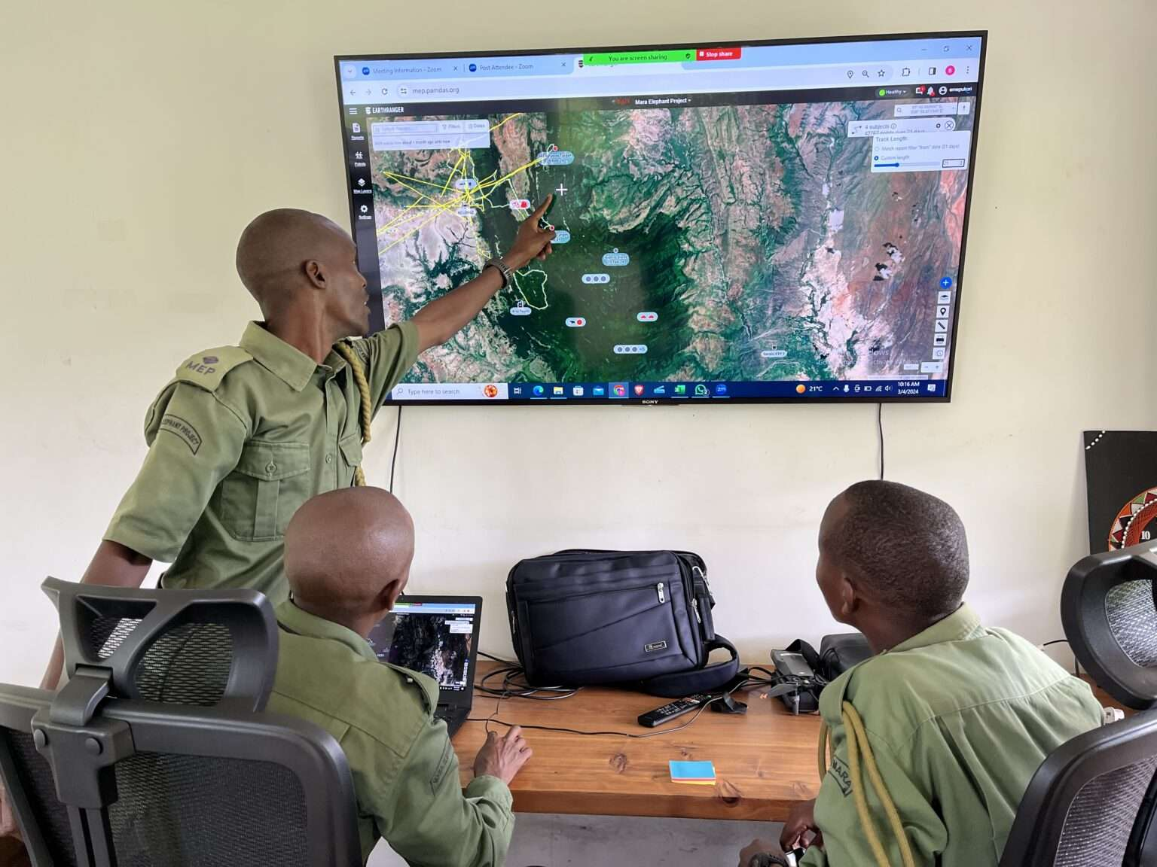
Activities: Data & Analysis
Become a Data Scientist
Activity 1: Map it. Use Google Earth to map elephant habitats and migration paths.
Activity 2: Visualize the Data. Analyze mock data to predict elephant behavior and find conflict zones.

Slide 9
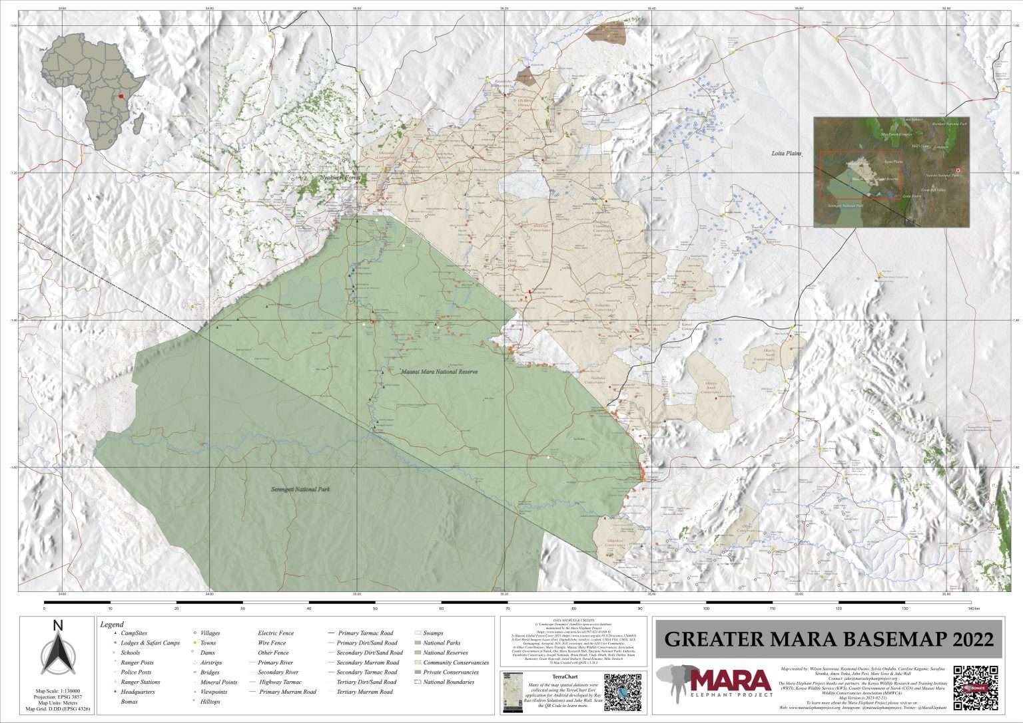

RESEARCH AND INNOVATION
Become a Tech Innovator
Activity 1: Research. Explore how technologies like RADAR and GPS work for conservation.
Activity 2: Innovate. Design a new technology solution to solve a real elephant conservation problem.

Slide 10
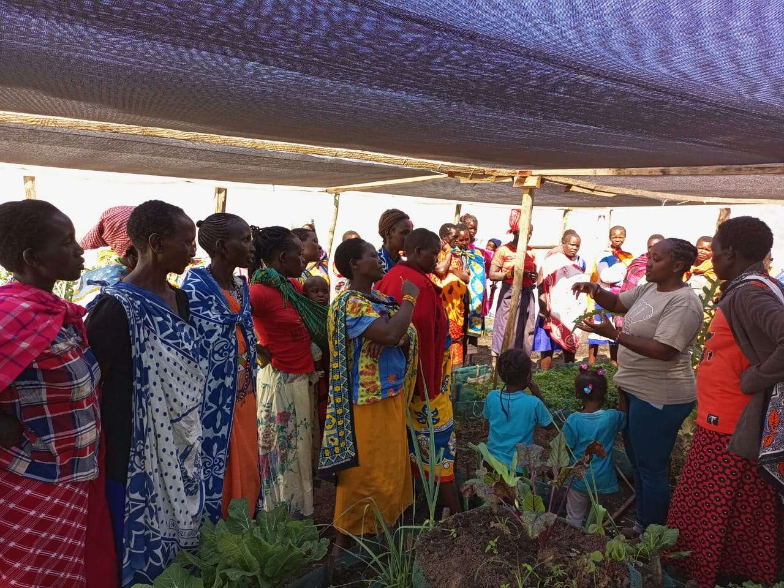
In Conclusion
The Interconnected World
Technology is a powerful tool for monitoring and protecting wildlife.
Data helps us understand complex ecosystems.
Community involvement is key to long-term success.

Slide 11
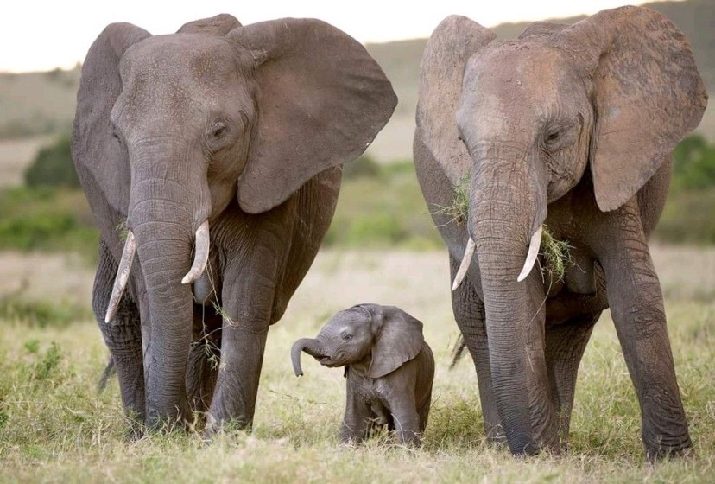
Thank You & Next Steps
What can you do?
Task: Write a brief reflection on how technology can solve a local wildlife challenge.
For more information on Geospatial technology contact @maraelephantproject

