Slide 1
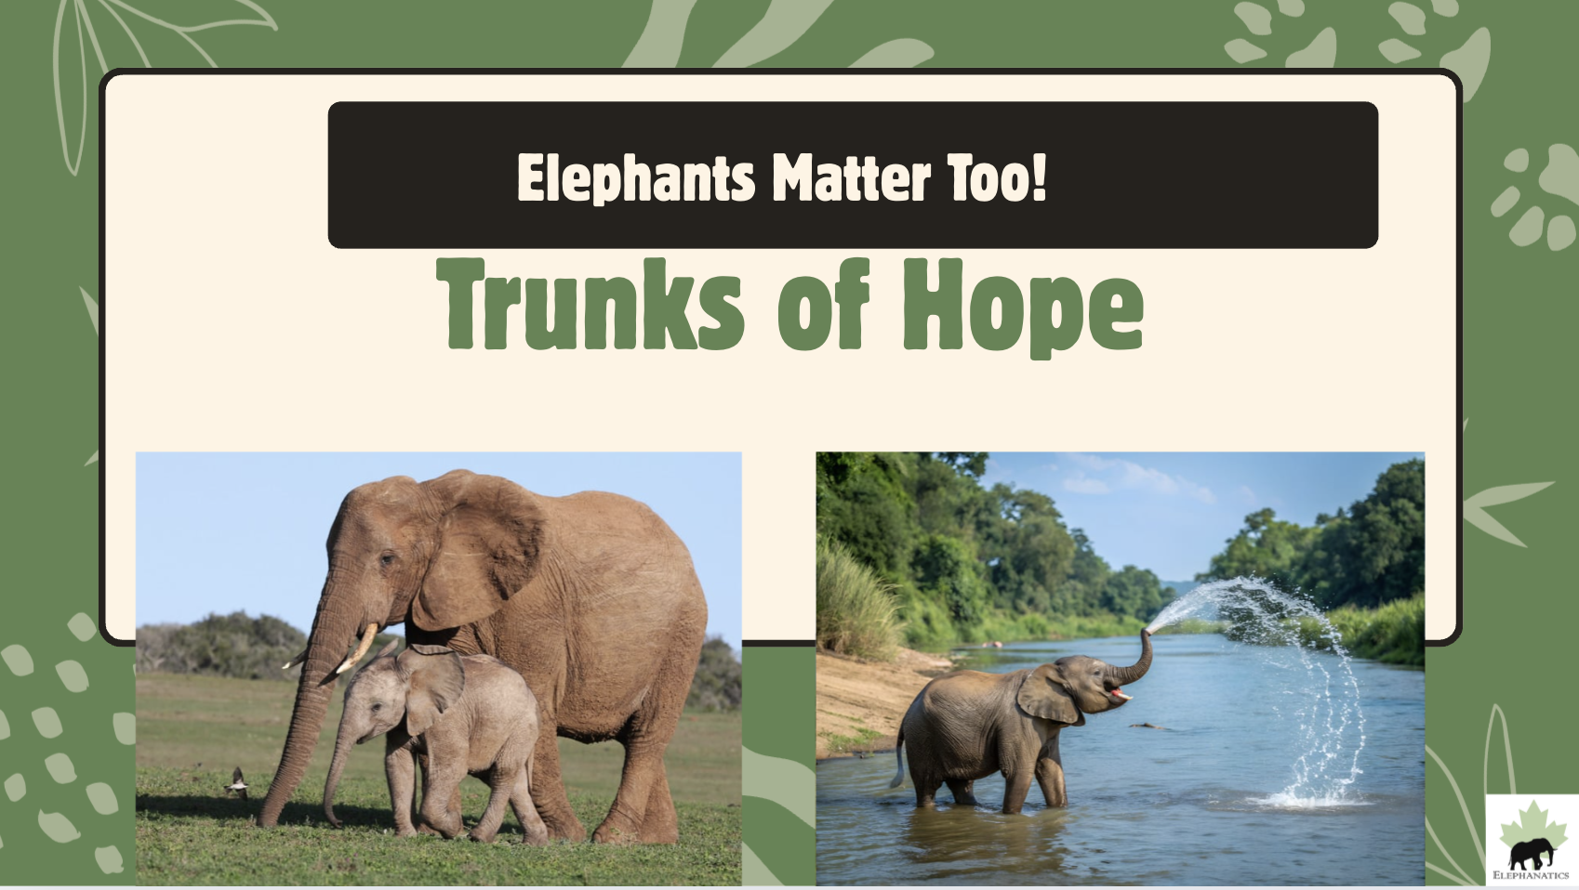

Slide 2
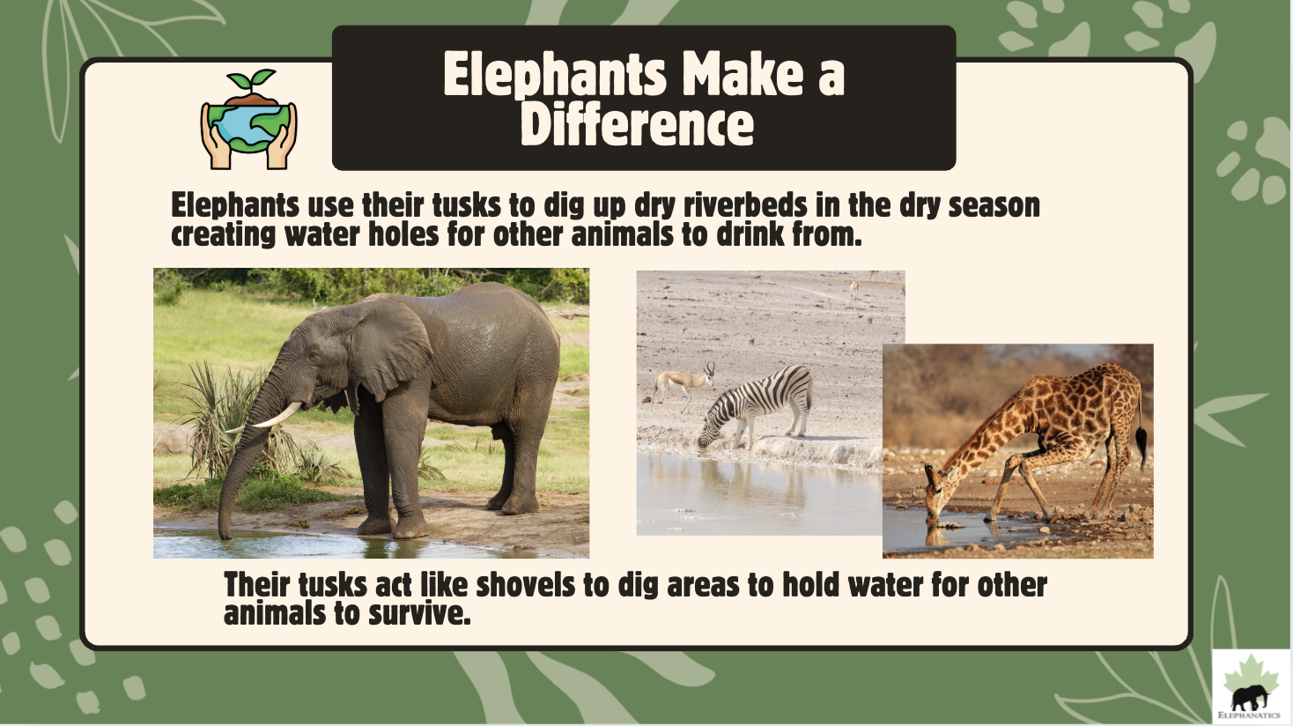

Slide 3
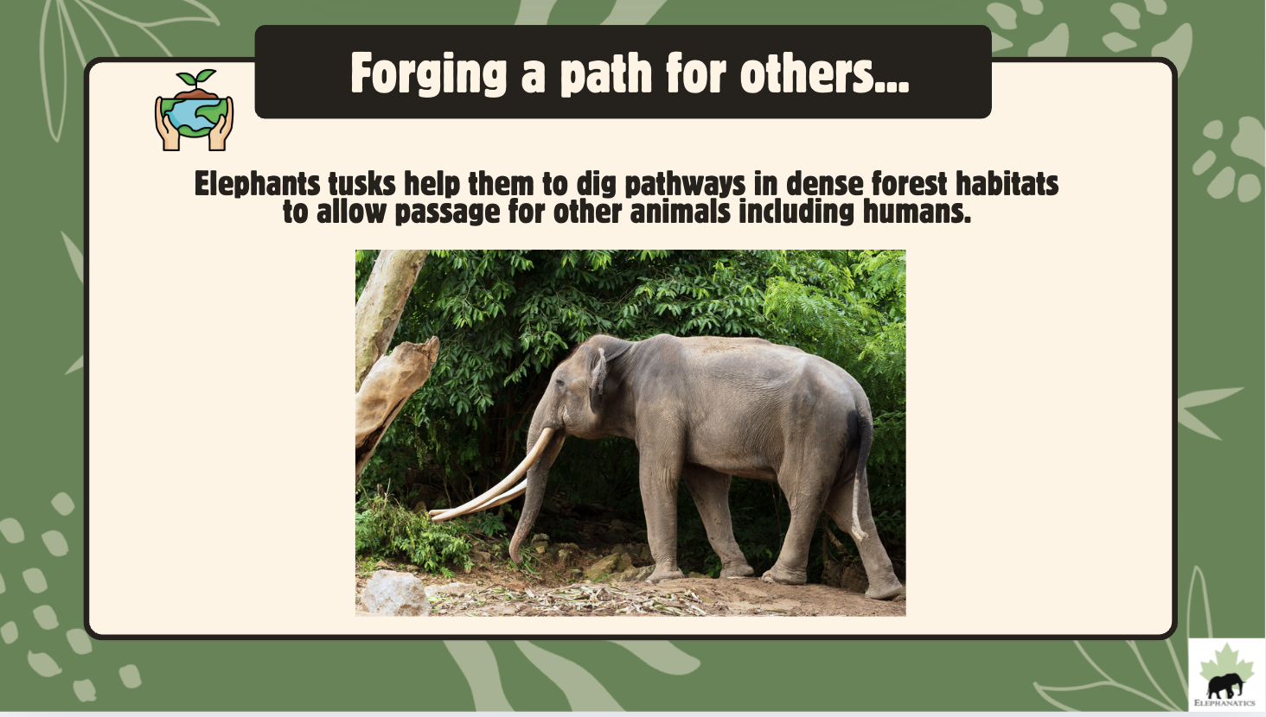

Slide 4
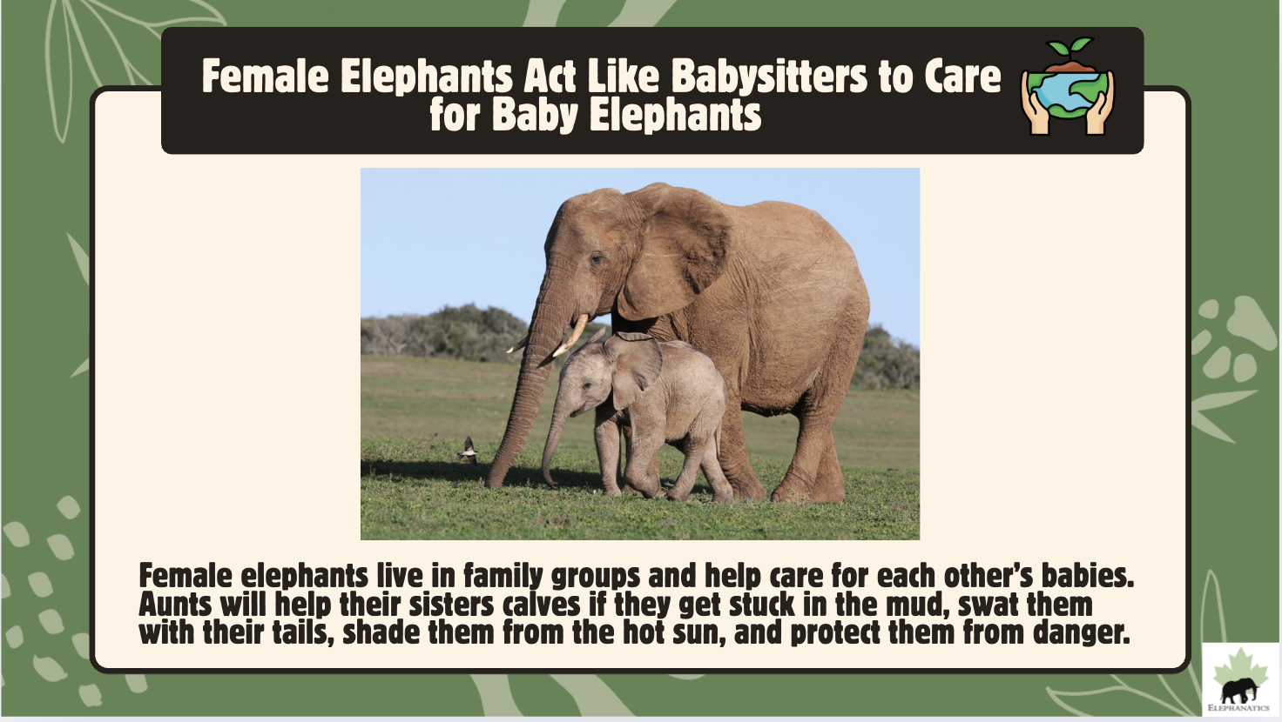

Slide 5

Elephants Never Forget

Slide 6
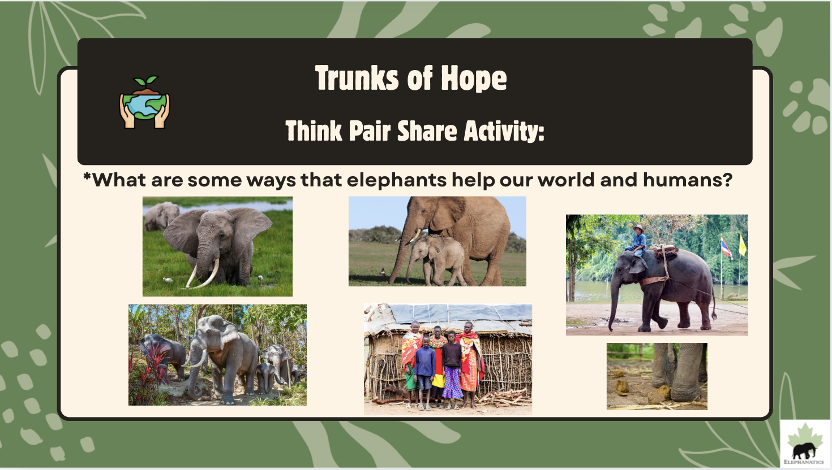
Notes:
"What are some ways that elephants help our world and humans?" Elephants play a big part in the world's biodiversity/climate change mitigation/ecosystem management and ultimately how that affects humans. It's advantageous to show the similarities between humans and elephants but the main point that needs to be emphasized: Elephants are needed for humans' survival. In any ecosystem, the loss of a keystone species results in a loss of biodiversity at other levels in the food chain. "Elephants have decreased by nearly two-thirds largely because of human activities in past 40 years."

Slide 7
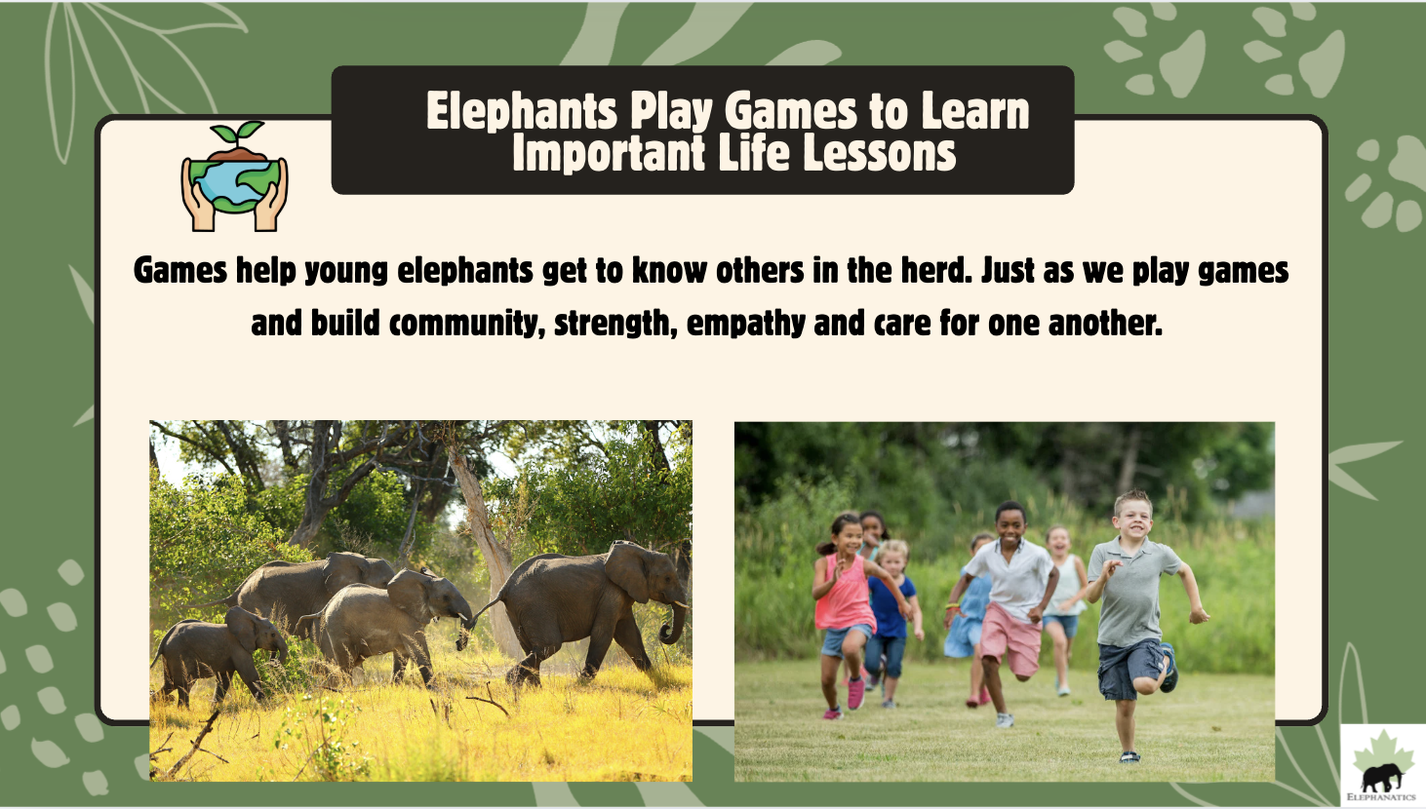

Slide 8
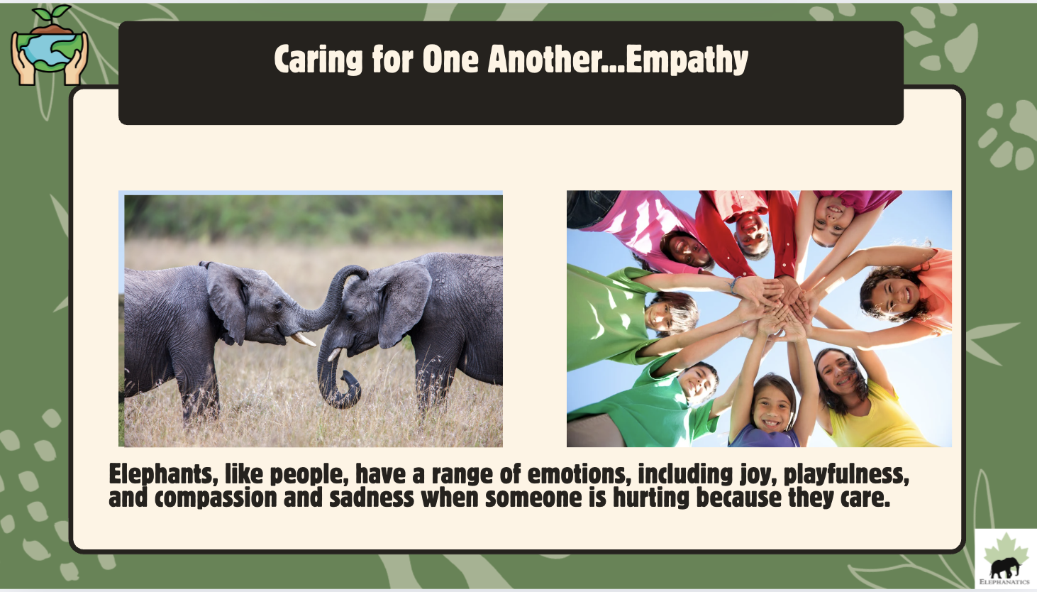

Slide 9
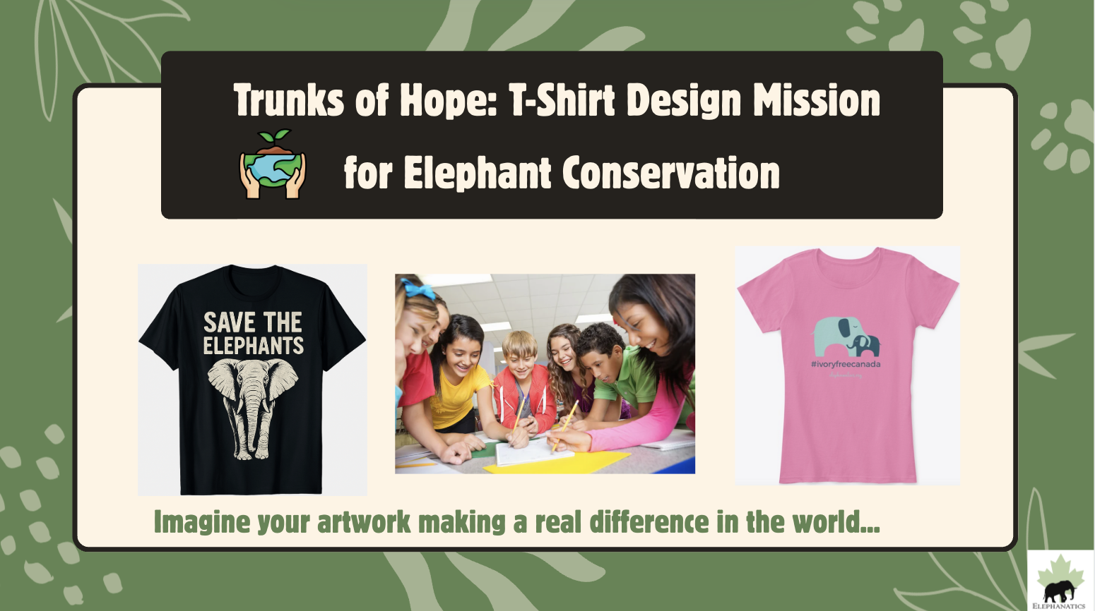

Slide 10
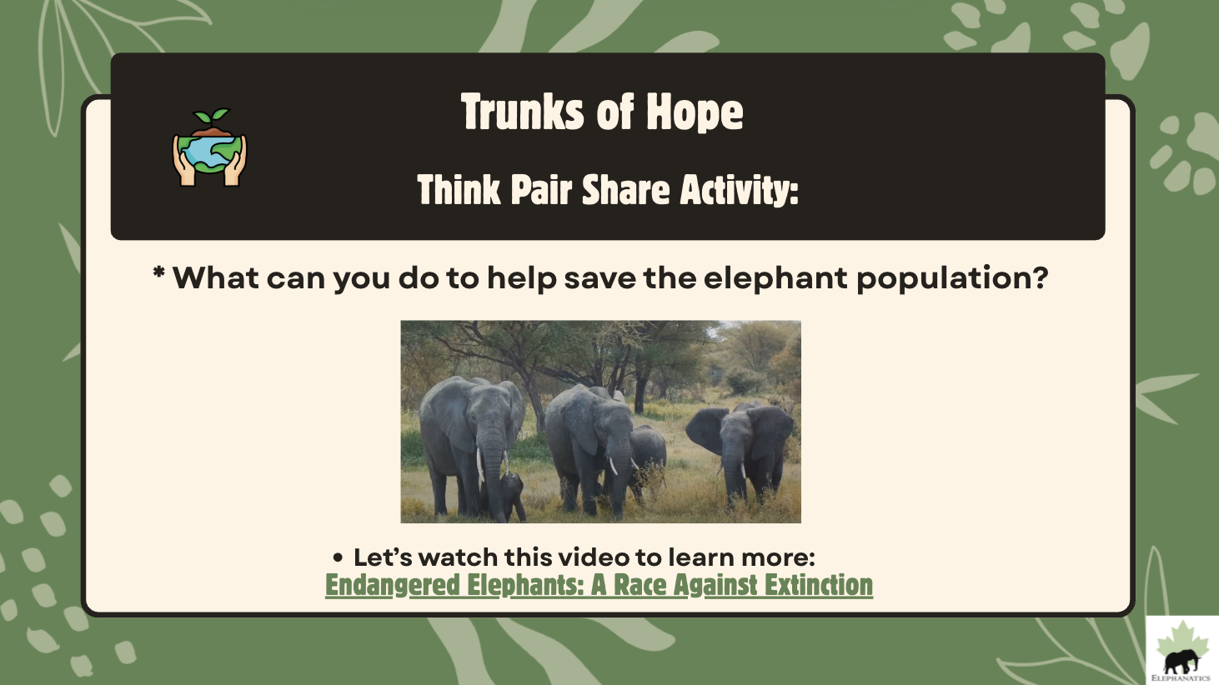
Endangered Elephants Video Link
Notes:
Think Pair Share Activity: What can you do to help save the elephant population to help our world?
Watch video: 1:47-2:47
Brainstorm ways to help: (possible ideas: Educate others how important elephants are with posters, video, presentation, announcement at school with Elephant Conservation Event: Fun Run to Raise Money for Conservation Efforts, Bake Sale, Posters at School, Create our own Video to share important information, Share slide show with other classes, Share an Elephant book or video, Write our government letters and ask them to protect elephants from poachers, Join T-shirt Contest and create a Conservation T-shirt to raise awareness, Book marks, Posters, hats, pins with original art work, add books about elephants to our library...brainstorm other ideas

Slide 11
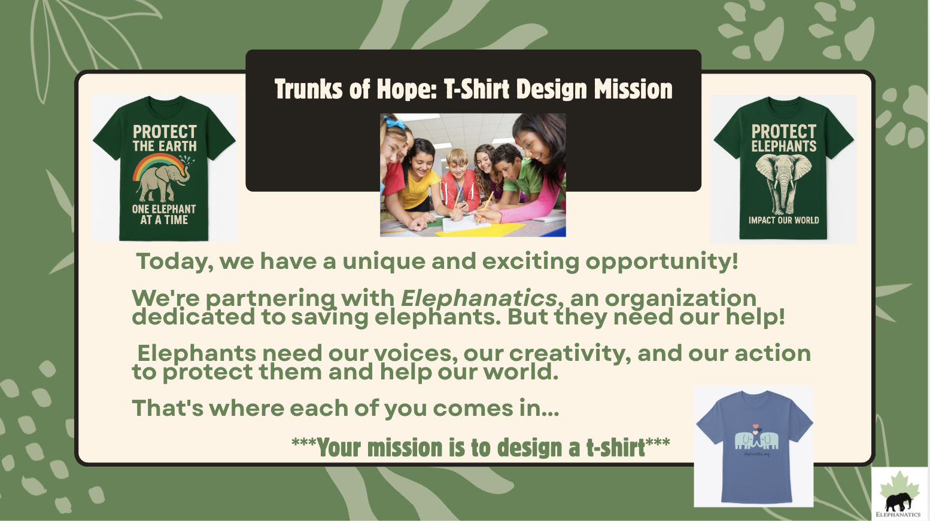

Slide 12
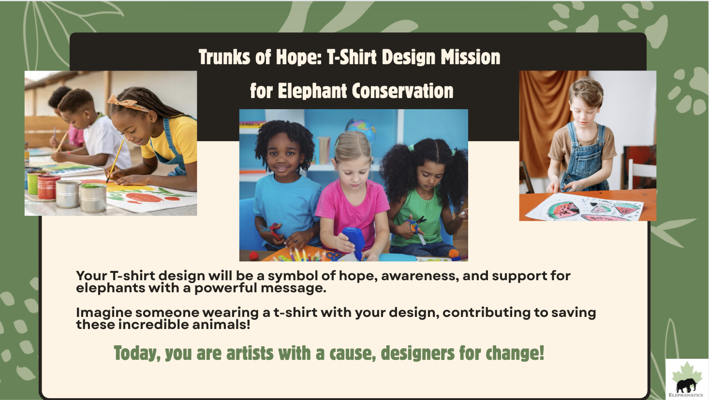
Notes:
Class Discussion: Share the role of awareness campaigns and fundraising in conservation
efforts. Share a few examples of t-shirts that have helped raise money to support causes.
*Have students focus on what aspects make the shirts
effective and brainstorm ideas.

Slide 13
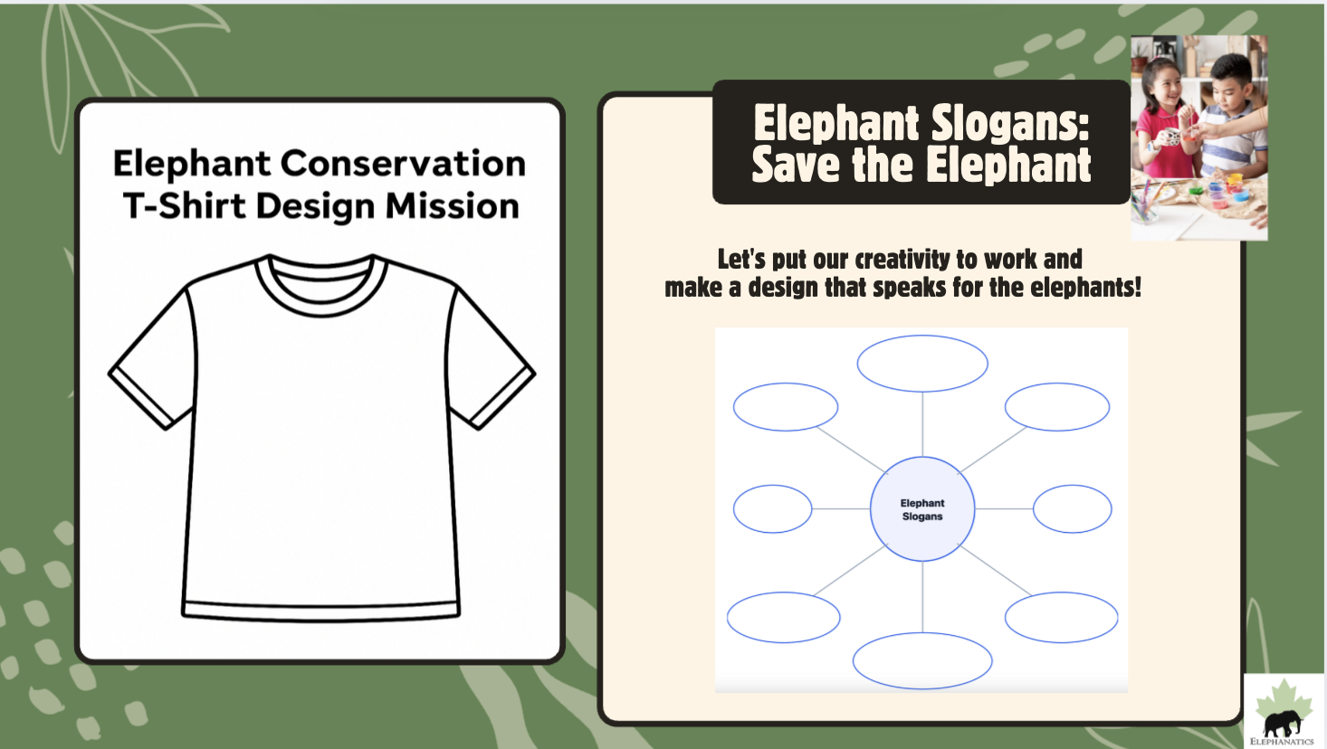
Notes:
Let's put our creativity to work and make a design that speaks for the elephants!
Think Pair Share:
Brainstorm slogans or mottos that we could put on a t-shirt, different images and colors students could use.
For example: Save the Elephants, Our World Needs Elephants, Help Now, Elephants for Earth Day... (think about alliteration, catch phrase, heartfelt message, action verb, rhyming words...
*Ask students what colors, images, shapes, pictures do they imagine

Slide 14
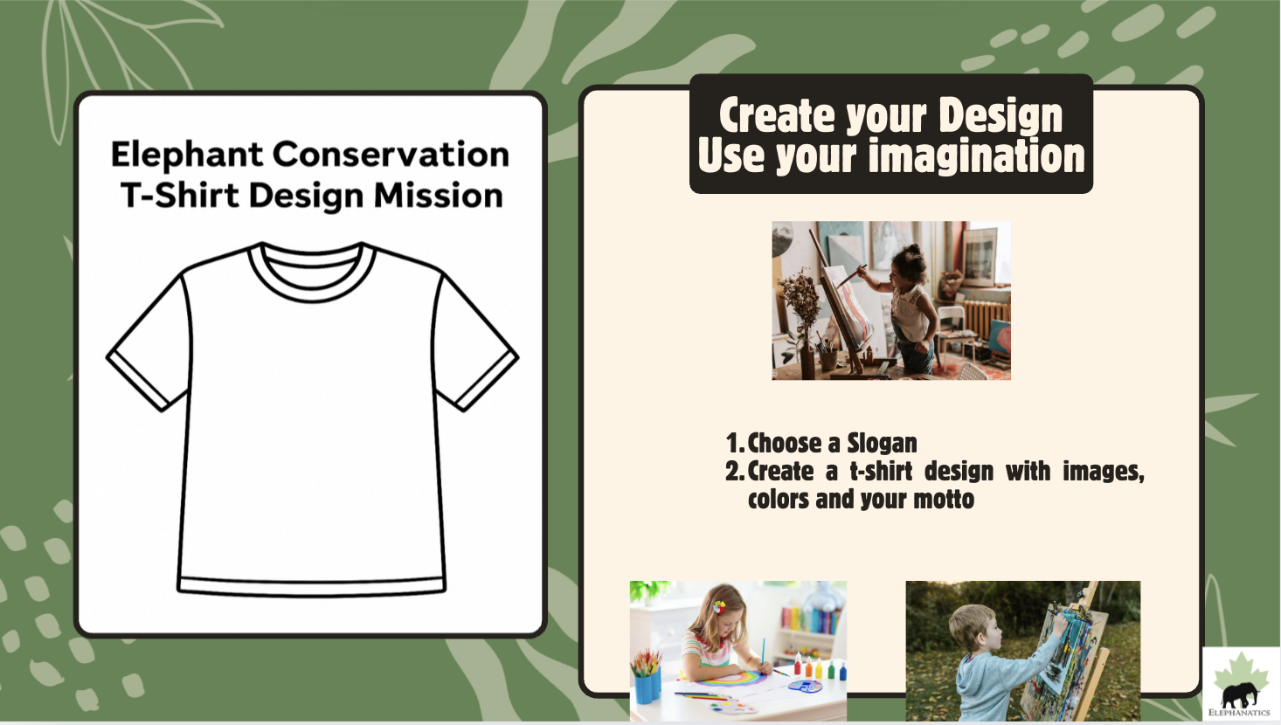
Notes:
• Individual to Small Group Teams Ideas Progression Example::
1. Begin by giving each student a few minutes to brainstorm ideas for the t-shirt design independently. o Encourage them to think about themes, slogans, images, and colors related to elephant conservation. o Provide paper and pencils for students to jot down or sketch their initial ideas. o Have students fold a piece of paper in half. On one side, they should write down words or phrases they want included in their design. On the other side, they should sketch or describe any images they included in their design.
2. • Pairing Up for Initial Discussion: o After individual brainstorming, students pair up with a classmate. o In their pairs, they share their ideas, discuss the strengths of each, and consider how they might combine or improve upon them. o This step allows students to refine their ideas and consider new perspectives.
3. • Forming Small Groups: In small groups, students share their combined ideas from the pair discussions. o Each group discusses the merits of the ideas presented, further developing and amalgamating them into more cohesive concepts. o Encourage students to consider practical aspects like how the design will look on a t-shirt and its appeal to potential buyers. • Creating Teams: o Several small groups can then come together to form larger teams. Ideally, each team should have around 4-5 members. o In these teams, students share the refined ideas from their small groups, opening up for a broader discussion. o Teams should aim to reach a consensus on a few key ideas or concepts that they feel best represent their collective vision for the t-shirt design. • Sketching Design Ideas in Teams: o Now, within their teams, students start sketching their t-shirt design ideas based on the agreed-upon concepts. o Encourage collaboration in this creative process, with students building on each other's strengths, whether it's in art, writing, or conceptualization. • Encouraging Creativity and Message Clarity: o Throughout the brainstorming and design process, reinforce the importance of creativity and clarity of message in their designs. o Remind students that the goal is to create a t-shirt that effectively communicates the message of elephant conservation and resonates with a broad audience.

Slide 15
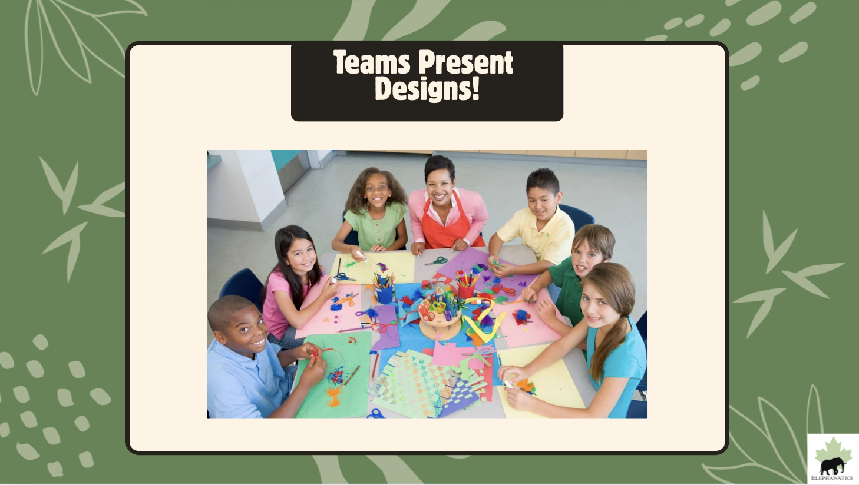
Notes:
Team Presentations:
o Each team prepares to present their t-shirt design to the entire class, including a brief explanation of their
design concept, the message it conveys, and any unique features.
o Teams can use visual aids, such as drawings or digital representations, to effectively showcase their
design.

Slide 16
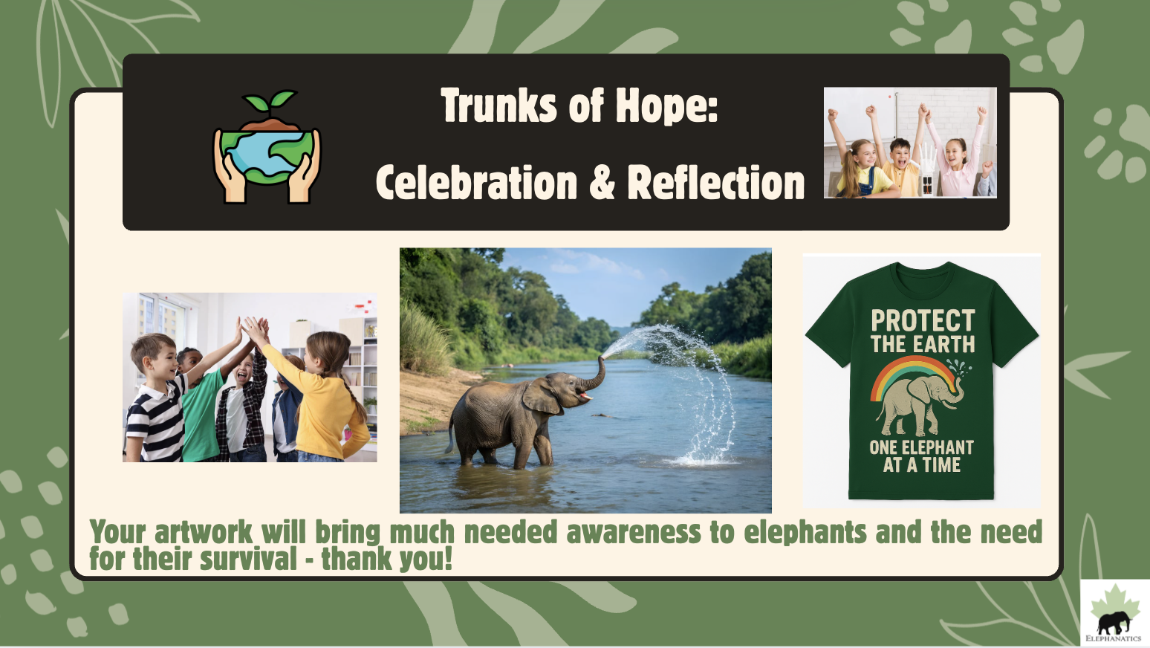
Notes:
Conclude with a ‘Reflective Sharing’ Activity:
• Individual Reflection: Have students individually reflect on the importance of elephant conservation, focusing
on what they've learned and why the cause matters.
• Group Sharing: Organize a circle for students to share their thoughts. Encourage concise statements about the
significance of saving elephants and additional conservation efforts.
• Exploring Further Actions: Facilitate a brief discussion on other ways to contribute to elephant conservation,
like community awareness activities or supporting conservation organizations.
• Reflect on Impact: End the class by having students share how this project has shaped their understanding of
elephant conservation and how they can apply these lessons in the future.

Slide 17
