Slide 1
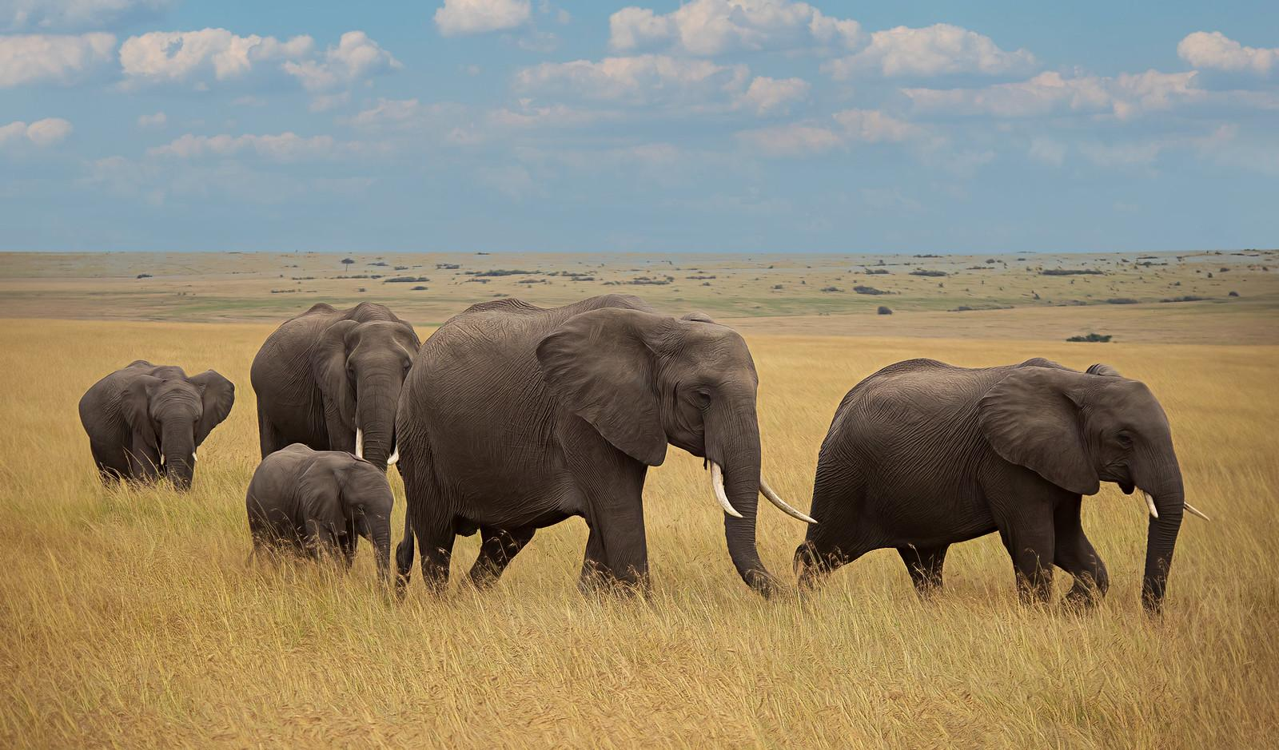
ELEPHANTS SENSES AND SURVIVAL
Learning from the World's Largest Land Animal
Grade Level: 4

Slide 2
OUR JOURNEY TODAY
Learning Goals:
Identify an elephant's key senses.
Discover how they respond to their environment.
Understand how elephants survive and thrive.
Learn about their role in the ecosystem.

Slide 3
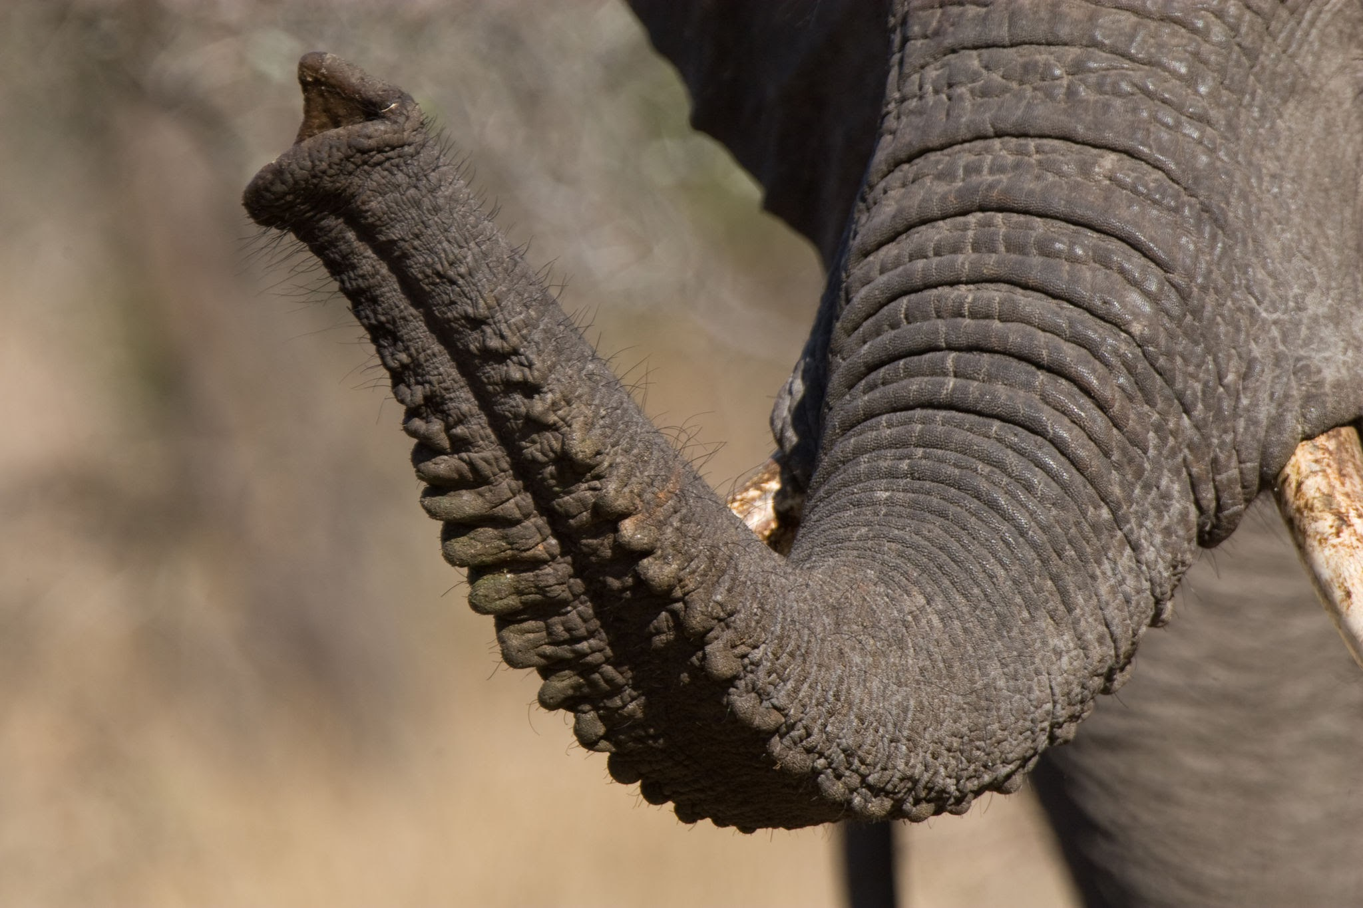
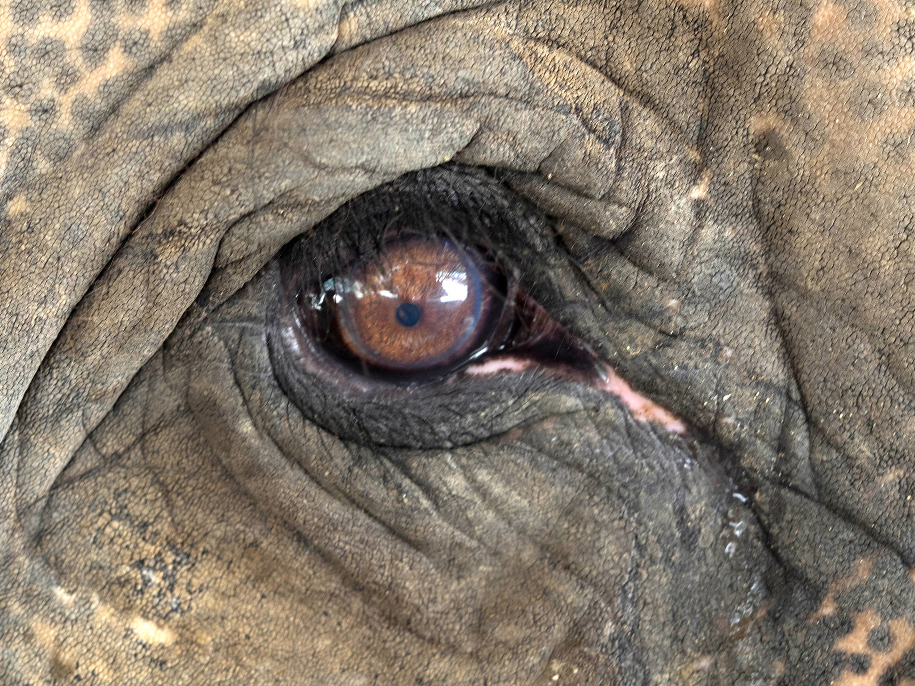
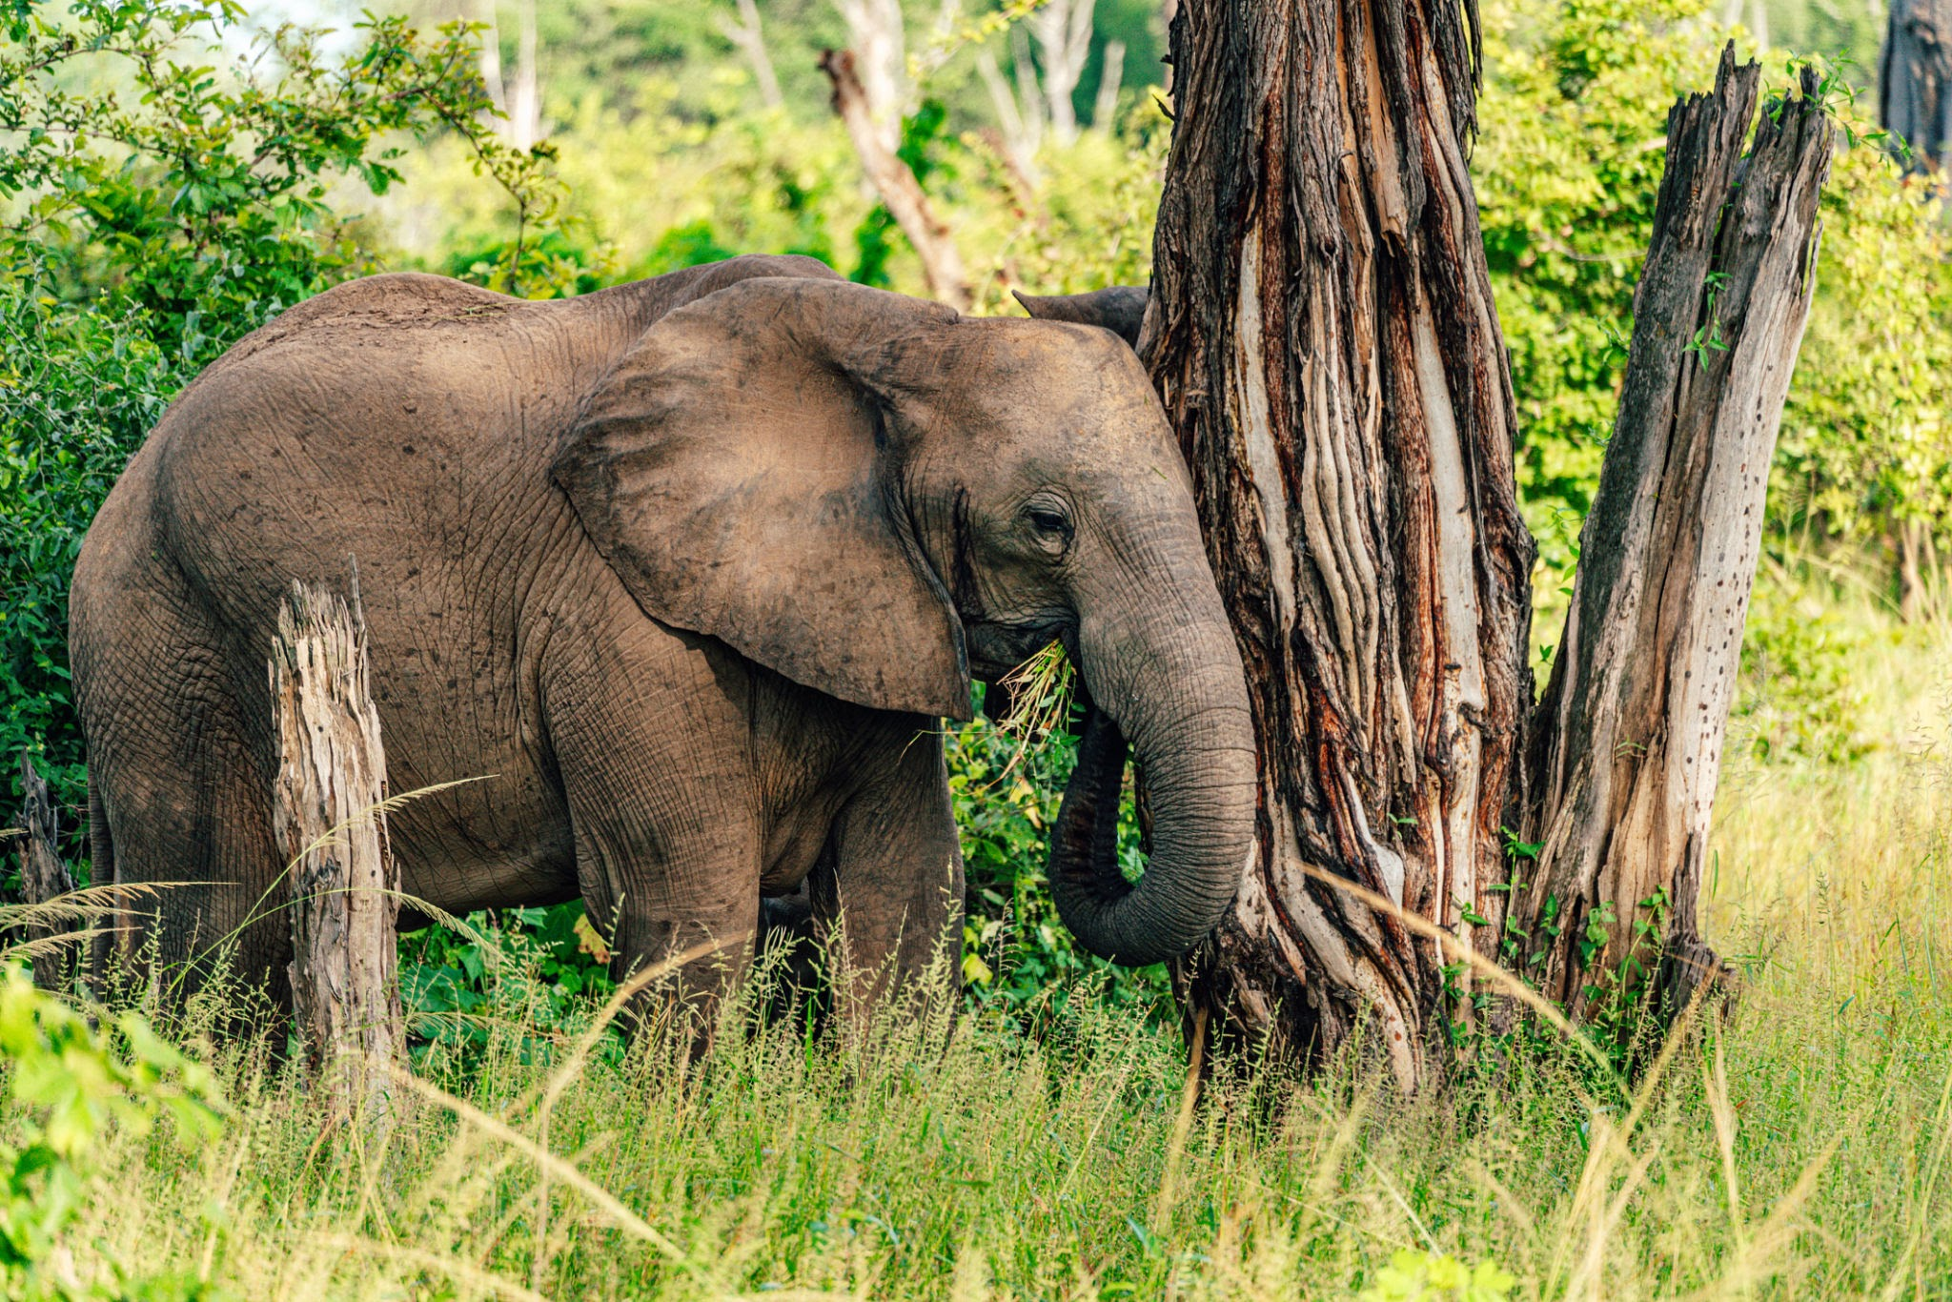
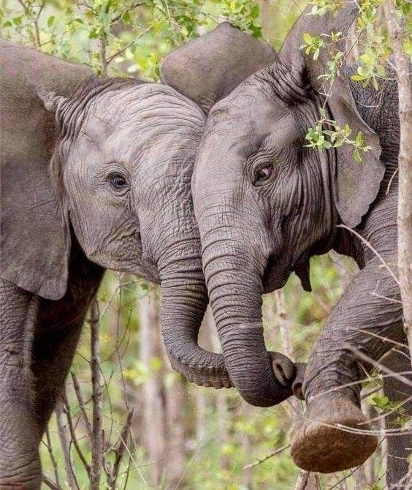
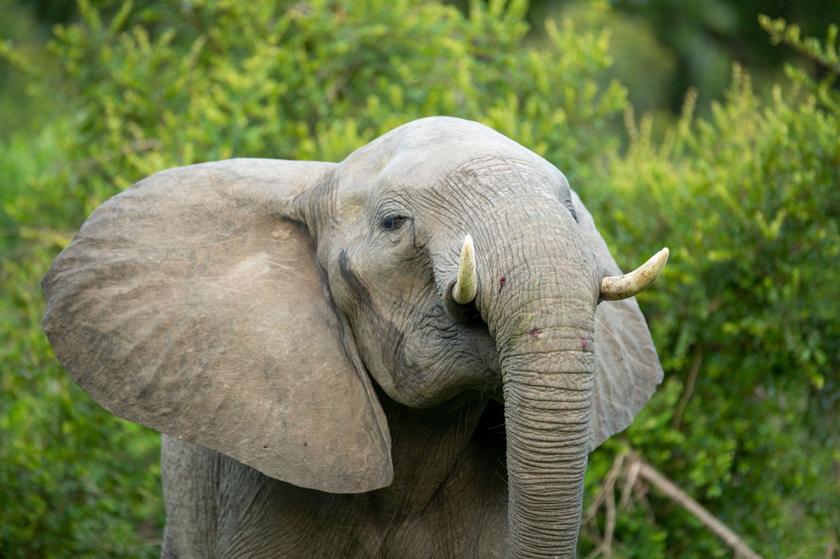
KEY SENSES USED BY ELEPHANTS
SMELL HEARING TOUCH VISION

Slide 4
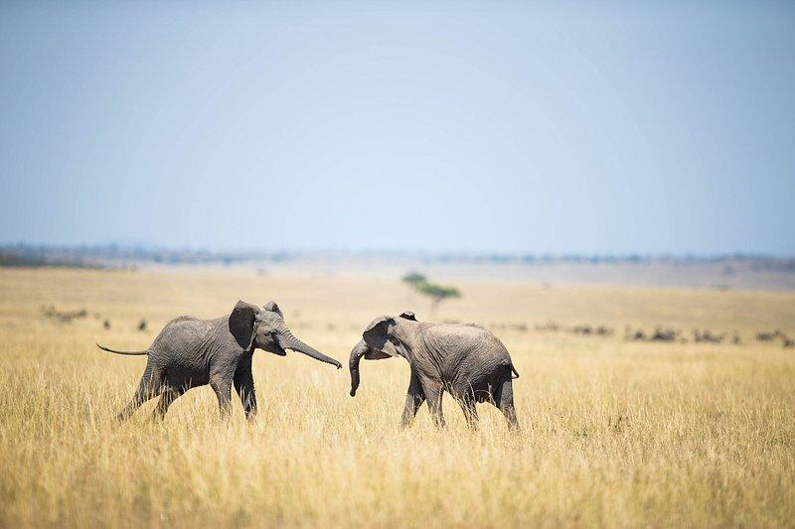
SUPER SENSES: THE NOSE KNOWS!
Their sense of smell is the best of any land animal. Elephants have the largest olfactory bulb of any land animal, which is the part of the brain that processes smells.
They have around 2,000 genes dedicated to detecting odors, compared to humans who have around 400.
Elephants can detect water sources from far away, sometimes miles away, using their sense of smell.
Elephants can also detect food, such as fruit or vegetation, from a great distance.
Elephant can even detect the scent of other elephants, including family members or potential mates.
Their trunks contain many sensitive olfactory receptors, which help them detect subtle changes in their environment.

Slide 5
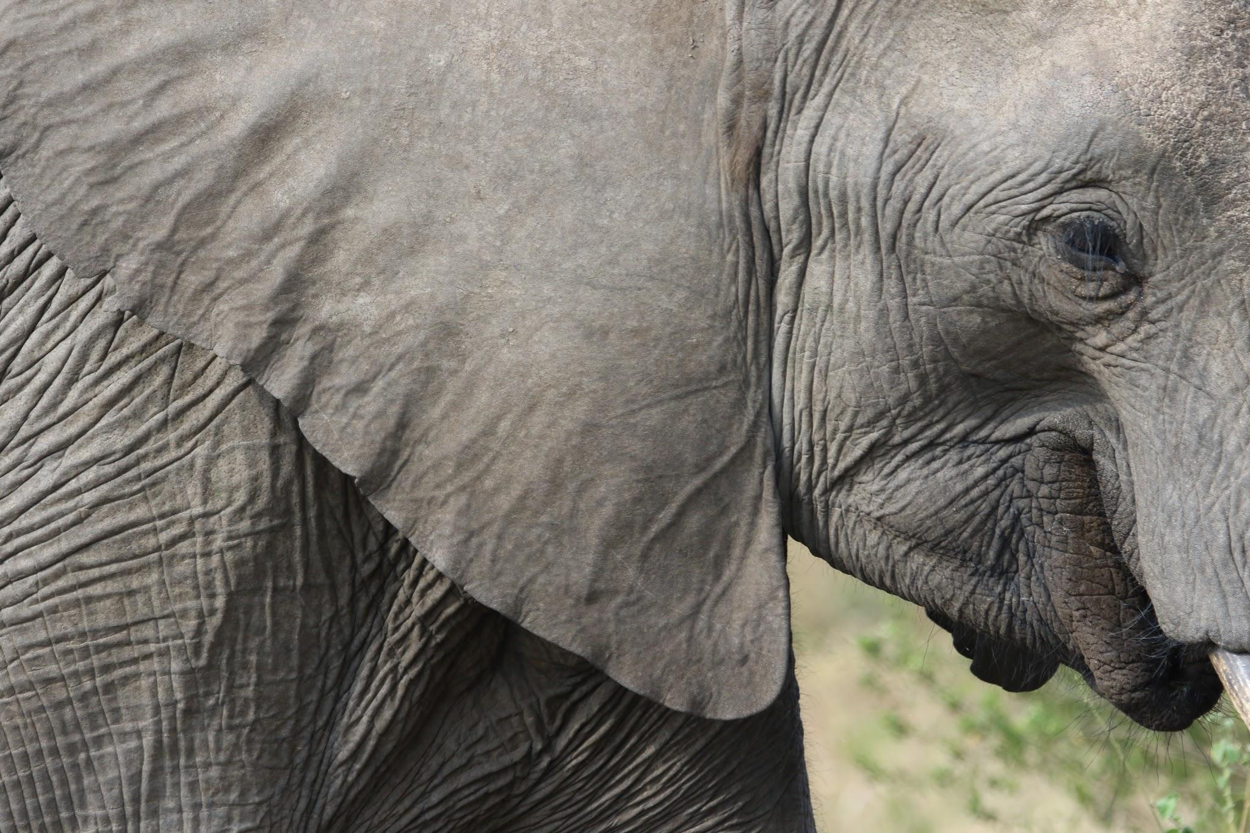
HEARING - BIG EARS BIG SOUNDS
Their ears can hear sounds from up to 5-6 miles (8-9.7 kilometers) away!
They communicate with low-frequency sounds (infrasound). They can detect low-frequency rumblings, often below the range of human hearing, which allows them to communicate with each other over long distances. Their large ears help them to pinpoint the source of sounds and detect vibrations in the air.
Elephants use their hearing to communicate with each other, detect potential threats, and navigate their environment.

Slide 6
TOUCH - THE WORLD IN THEIR TRUNK
Nerve Endings: The trunk contains over 400,000 neurons that transmit sensory information to the brain, giving it an incredible level of tactile specialization. This density of nerve endings is one reason they can perform both powerful and delicate tasks.
Precision: The tip of the trunk, often compared to fingers, is extremely precise. African elephants have two finger-like projections and Asian elephants have one, but both can perform fine motor tasks, such as picking a single blade of grass or a coin off the ground.
They use touch to greet each other and explore:
Greeting Ceremonies: When elephants from different family groups reunite, they engage in elaborate greeting ceremonies that are highly tactile. They intertwine trunks, touch each other's faces, and press their bodies together. These physical interactions are essential for reaffirming social bonds and updating each other on their well-being.
Social Bonding: Elephants constantly use touch to maintain social cohesion within their herd. They use their trunks to caress, stroke, and reassure one another. This is particularly important between a mother and her calf, where trunk-to-body contact provides comfort and security.
Exploration: An elephant's trunk is its primary tool for exploring its environment. They constantly touch and feel objects, using their trunk's sensitivity to assess everything from the texture of a branch to the temperature of water. This tactile exploration is a critical part of how they gather information and navigate their world.

Slide 7
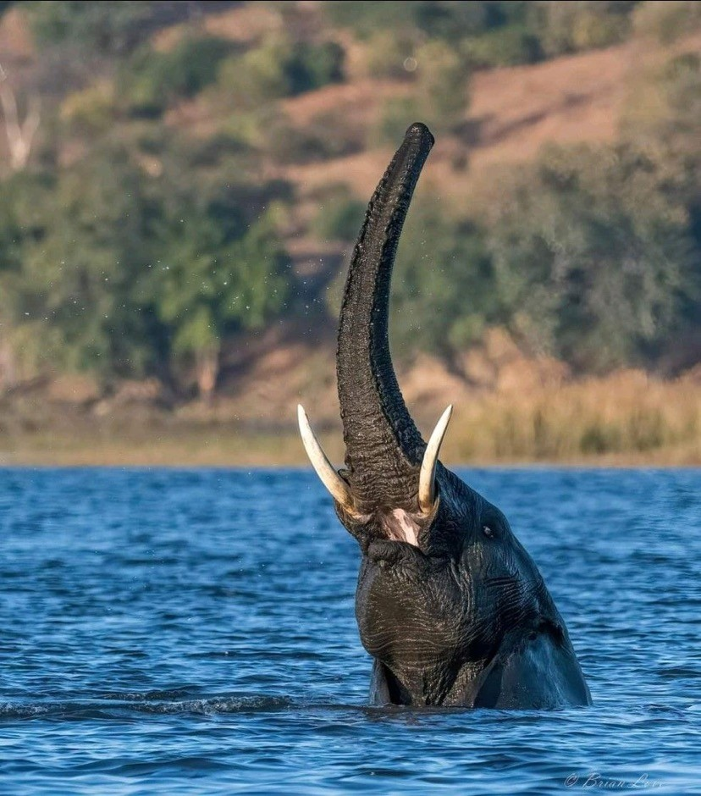
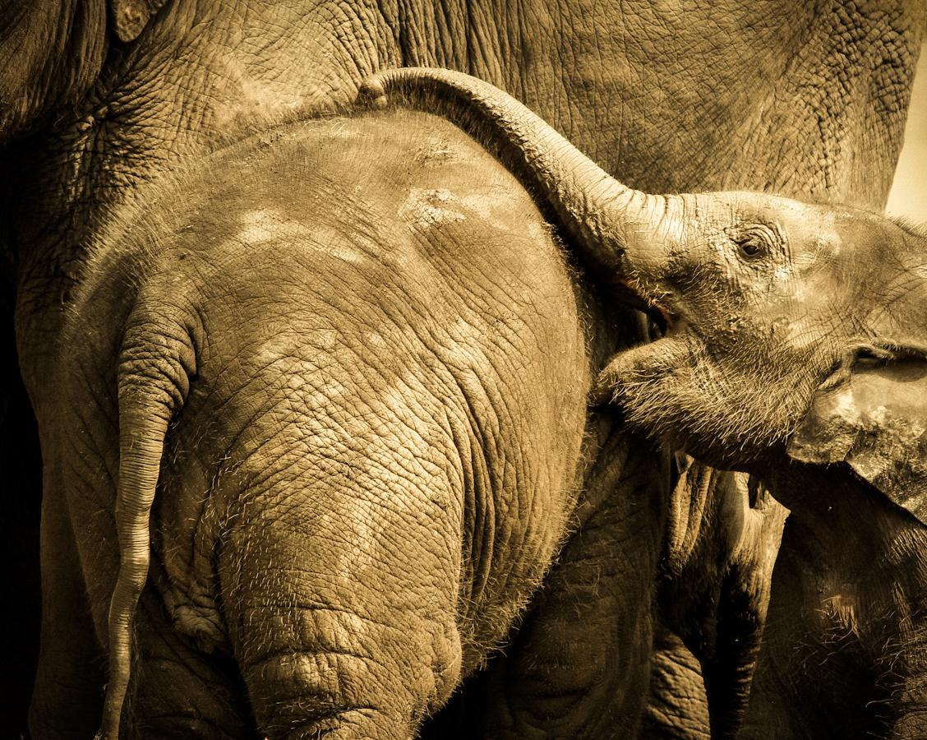
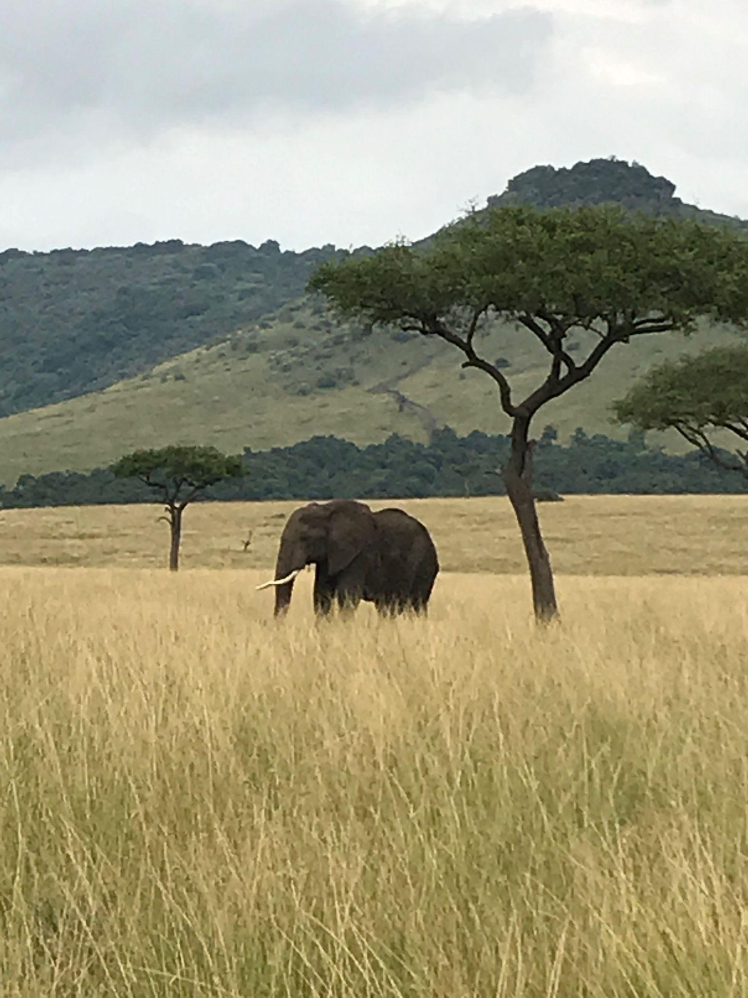
TOUCHING - SMELLING - EXPLORING!
An elephant's trunk is an incredible appendage capable of many complex and varied tasks!

Slide 8
VISION - NOT THEIR STRONGEST SENSE!
An elephant's vision is not their strongest sense, but it is still a vital tool that helps them navigate their world. While they rely more heavily on their acute sense of smell and hearing, their vision helps them in several key ways:
Navigation and Stability - They use their sight to judge foot placement
Detecting Movement - With their eyes located on the sides of their head, they have excellent peripheral vision. This allows them to quickly spot predators, other elephants, or potential threats approaching from the sides
Social Cues - Elephants use their vision for close-range communication within the herd. They can recognize individuals, read body language, and understand visual signals from other elephants, such as a raised trunk or flared ears.

Slide 9
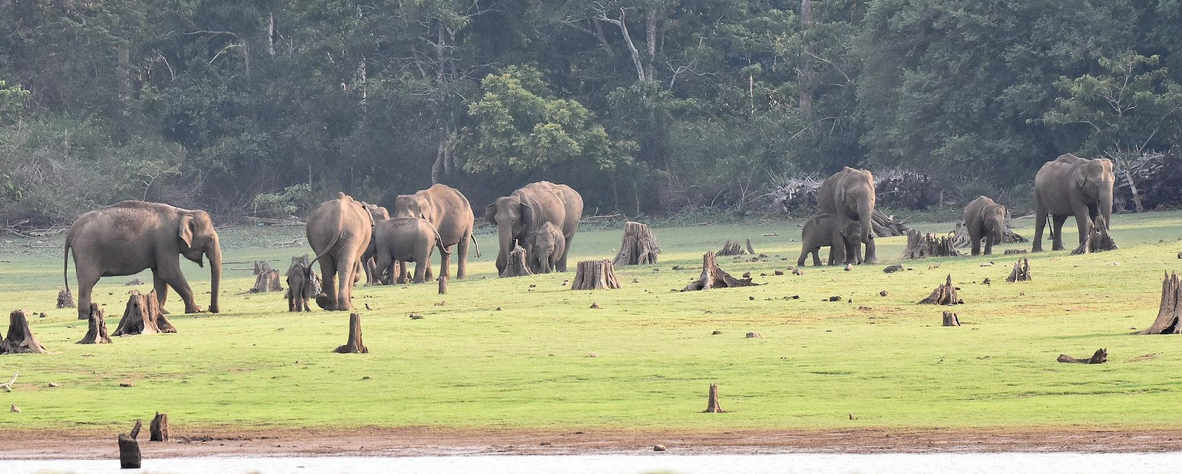
ELEPHANT ADAPTATIONS
BUILT TO SURVIVE:
LARGE SIZE: Deters predators and helps control body temperature
THE TRUNK: A multi-toll for eating, drinking, and communication
LARGE EARS: Used for both hearing and keeping cool
SOCIAL BONDS: Living in a herd for safely and support.

Slide 10
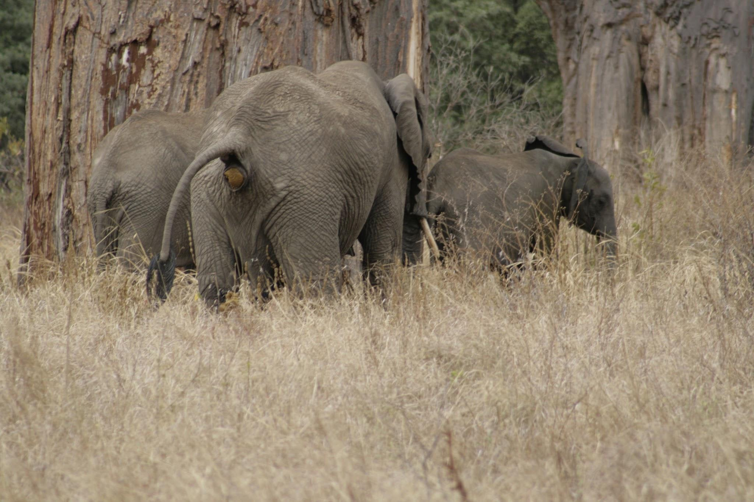
THE ELEPHANTS ROLE
Ecosystem Engineers
Seed Dispersal: They eat fruit and help spread seeds
Creating Water Sources: They use their trunks to dig for water
Shaping Landscapes: Their movement creates paths and clearings.

Slide 11
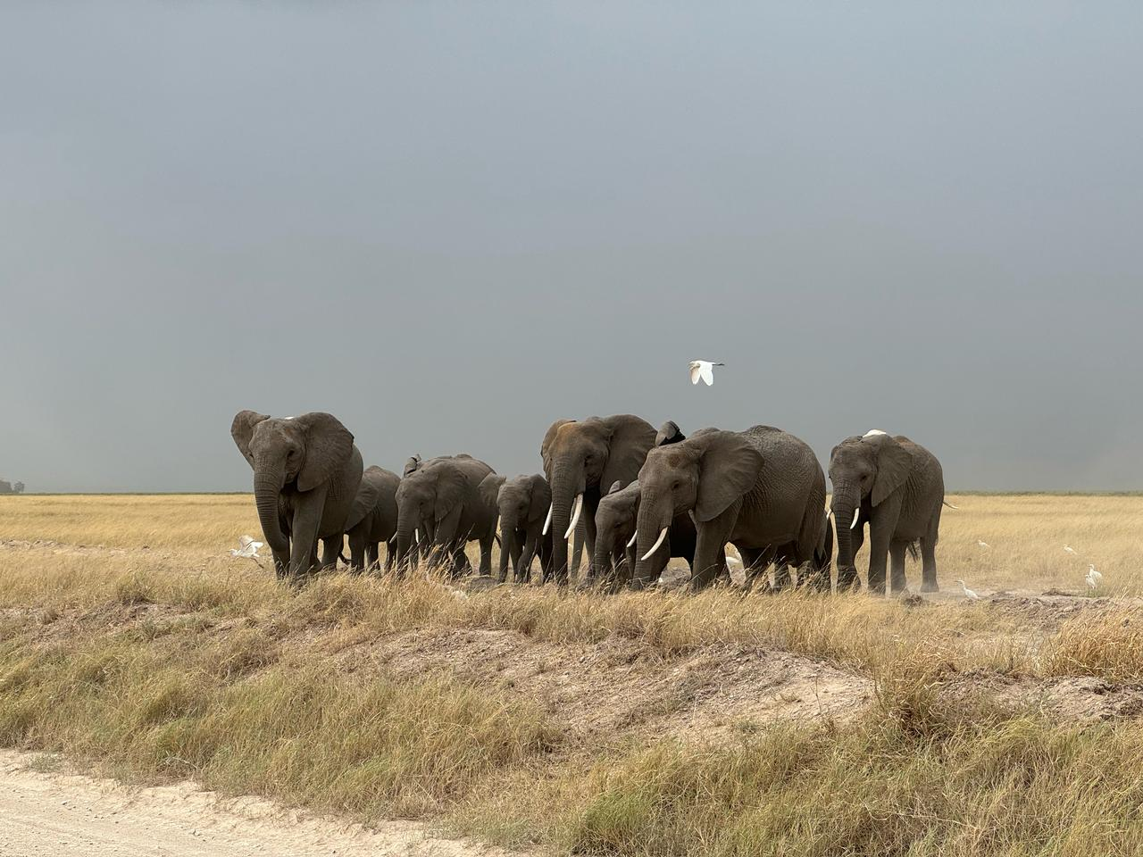
RESPONDING TO THE WORLD
FROM DANGER TO DINNER
THREATS: They form a defensive circle to protect the young.
FINDING FOOD: They migrate to new areas in search of food and water.
FAMILY: They touch and vocalize to stay connected.

Slide 12
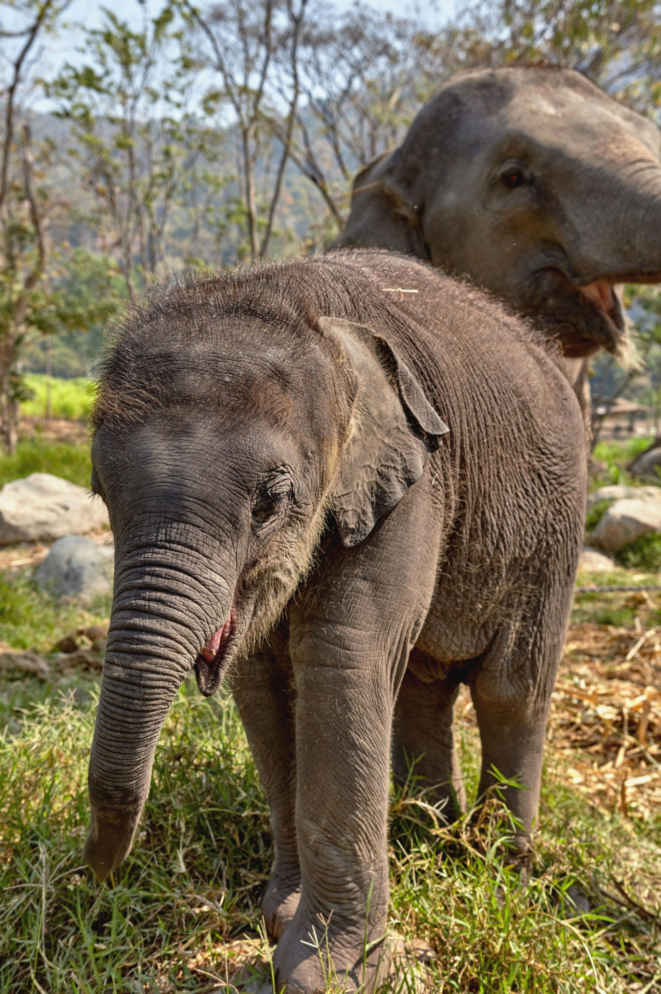
CONCLUSION
WHAT DID WE LEARN?
Elephants use an incredible set of senses to survive.
Their unique adaptations help them thrive.
They are essential for a healthy ecosystem.

Slide 13
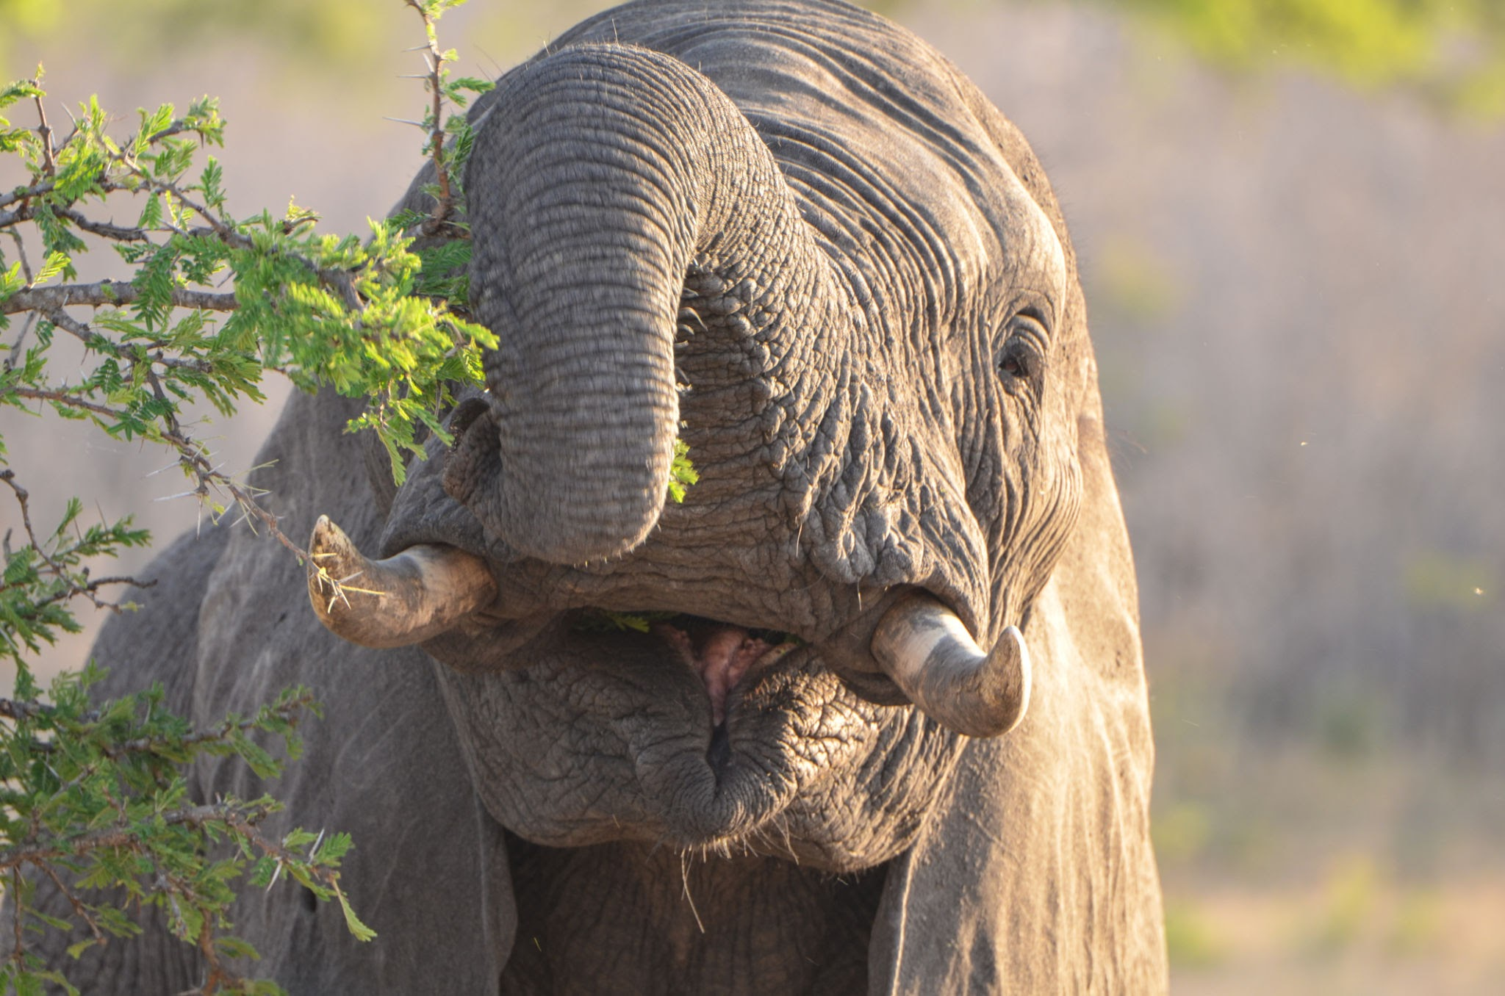
FINAL TASK!
Your Turn!
Task: Write a short paragraph about your favorite elephant sense or adaptation.

